Slide 1
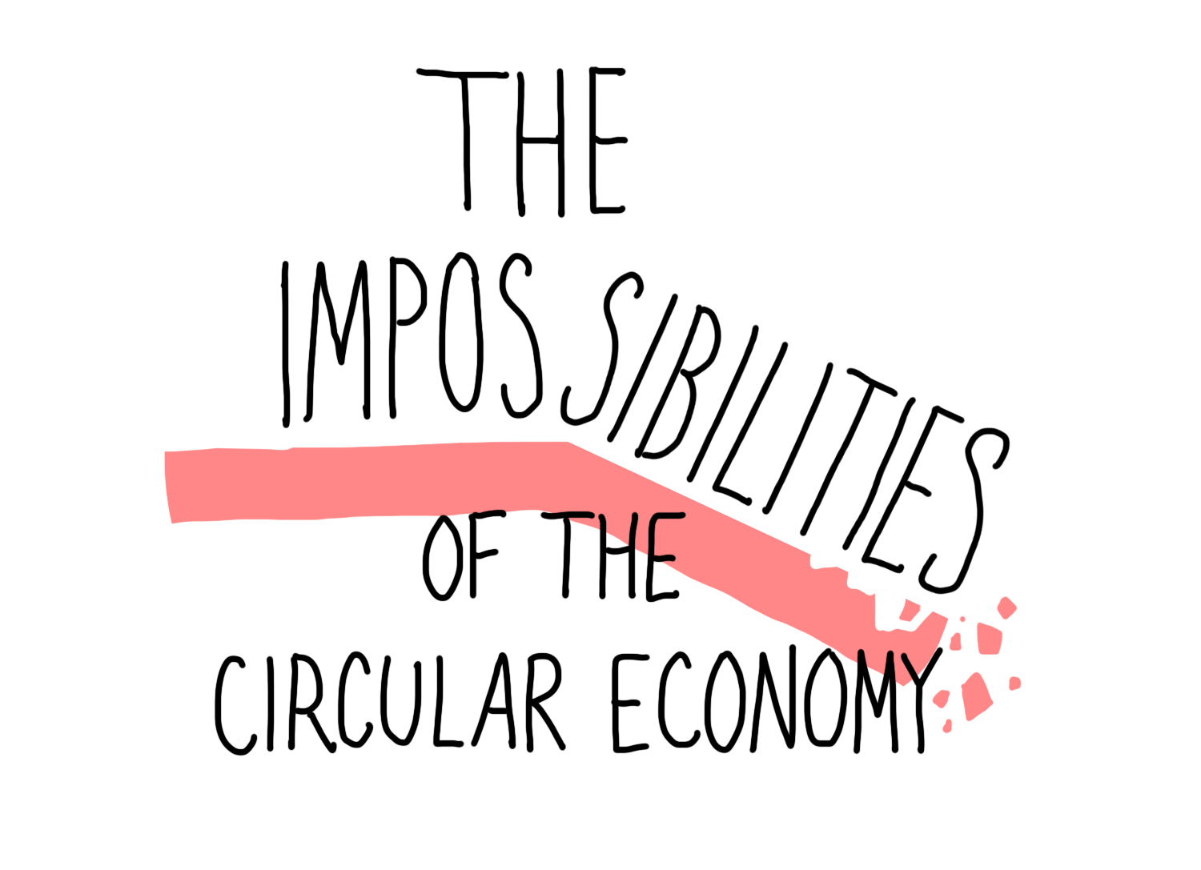

Slide 2
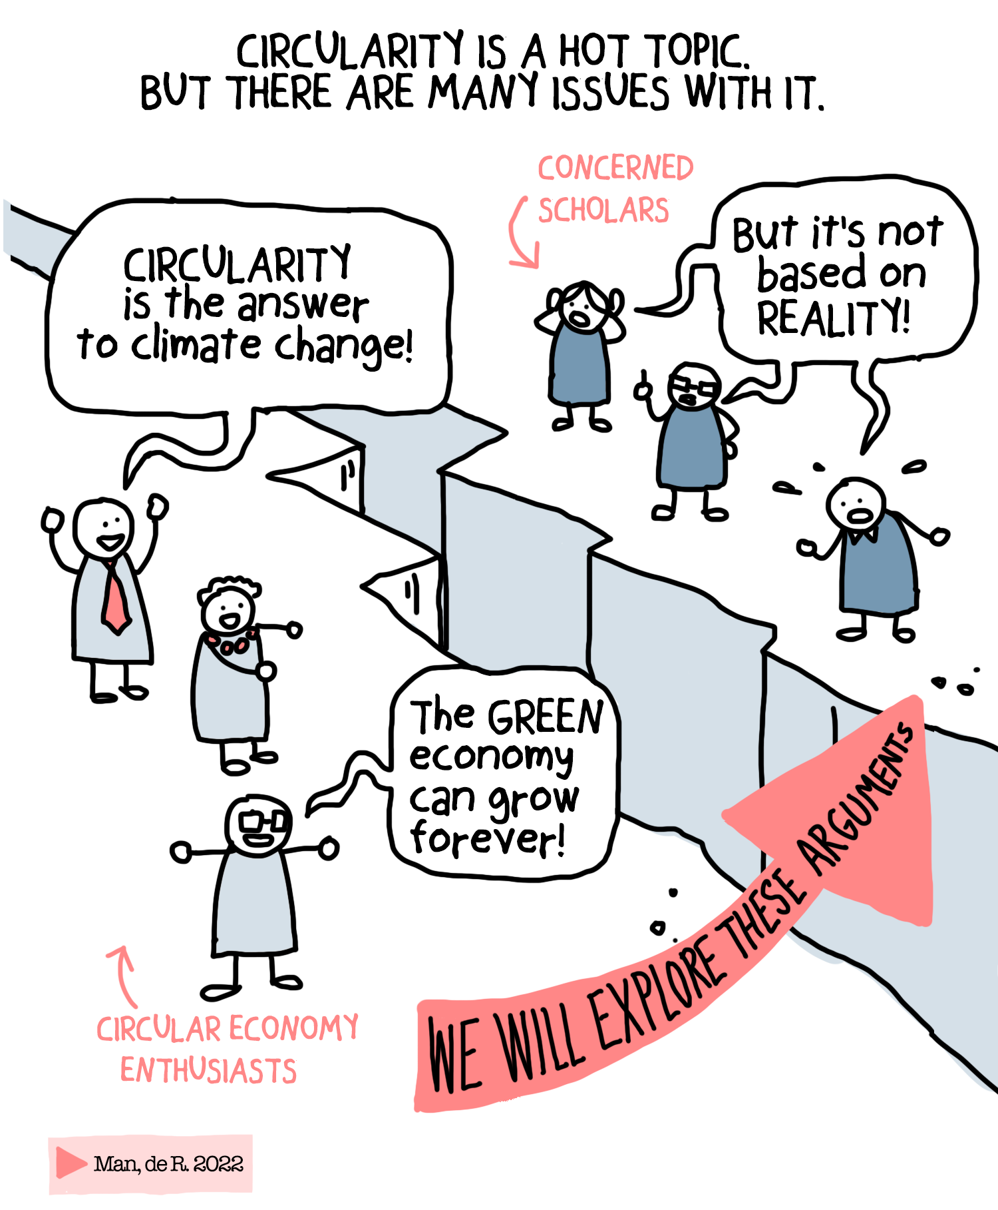

Slide 3
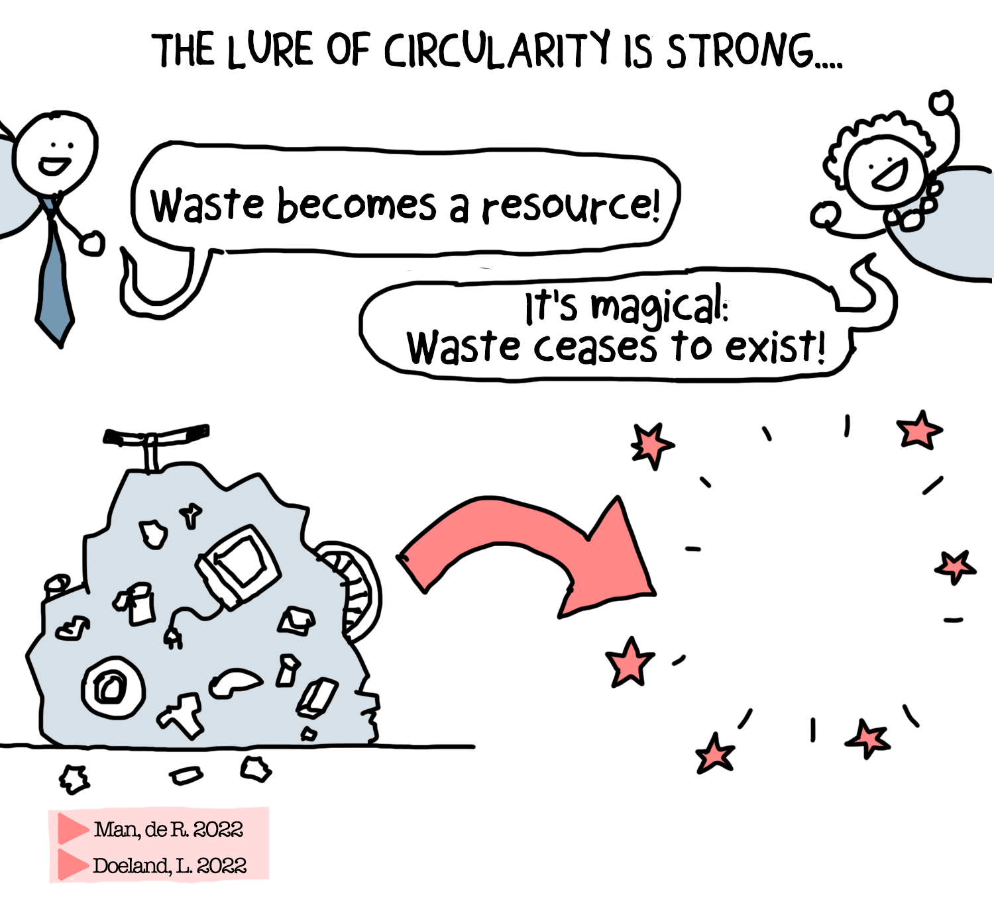

Slide 4
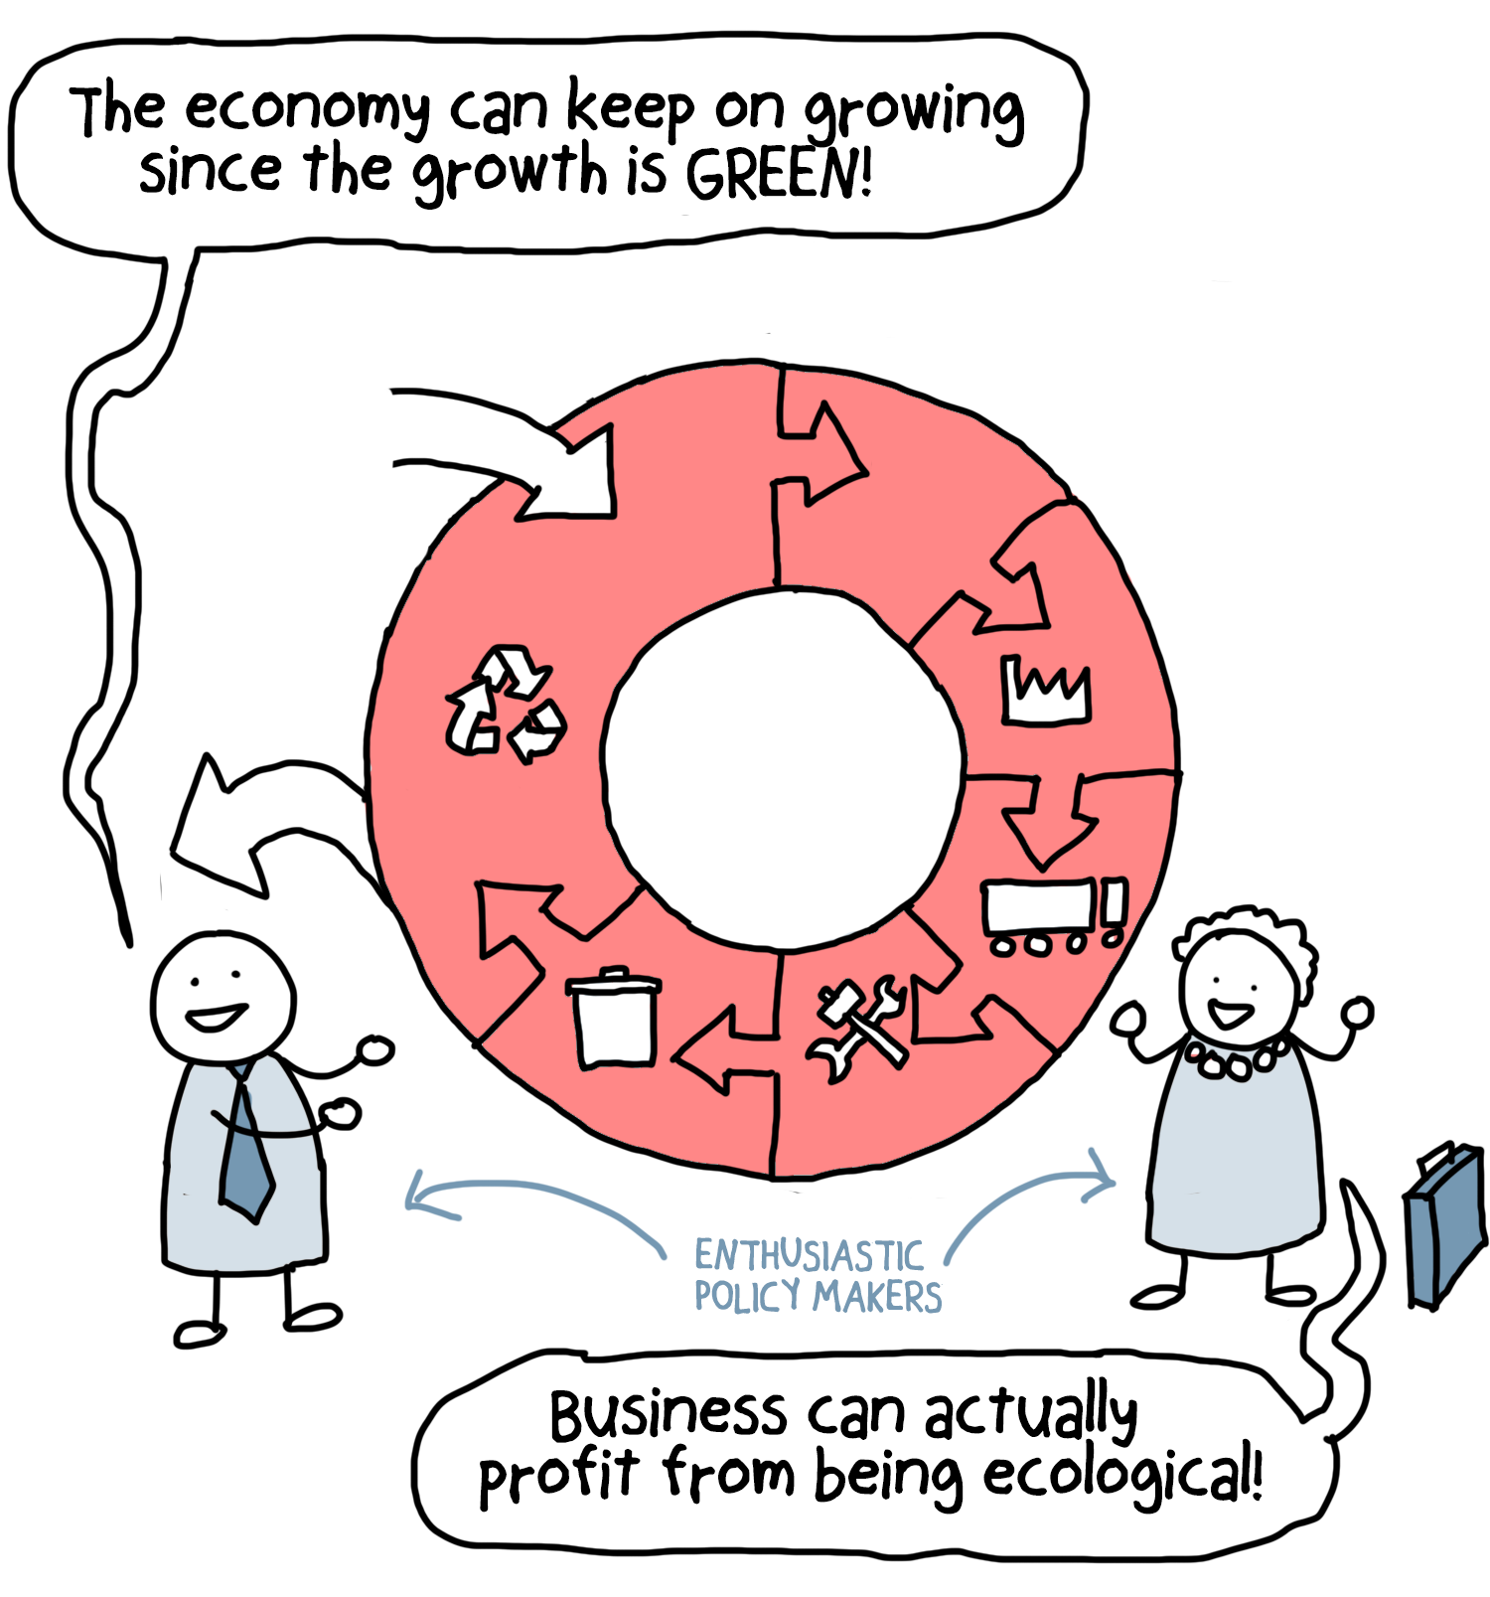

Slide 5
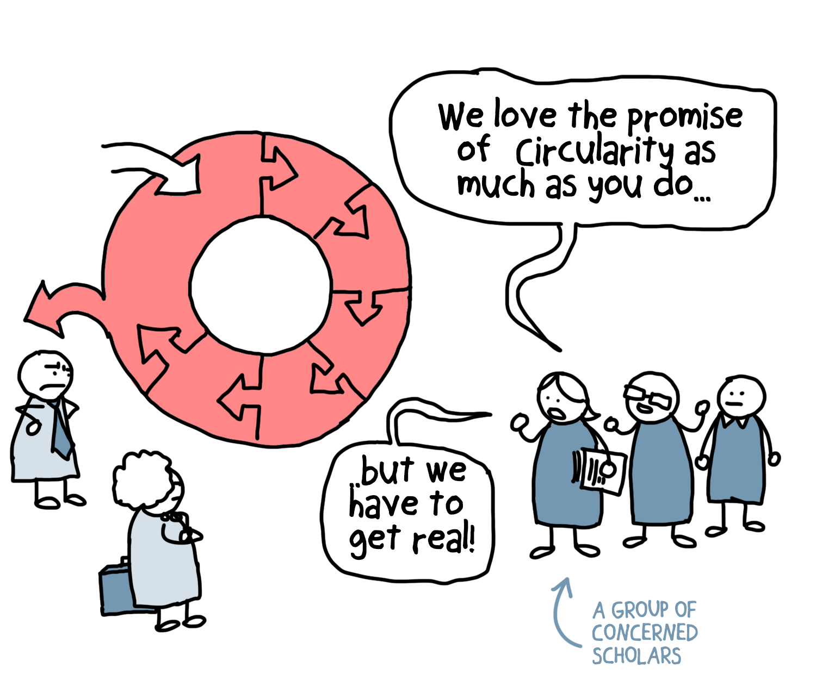

Slide 6
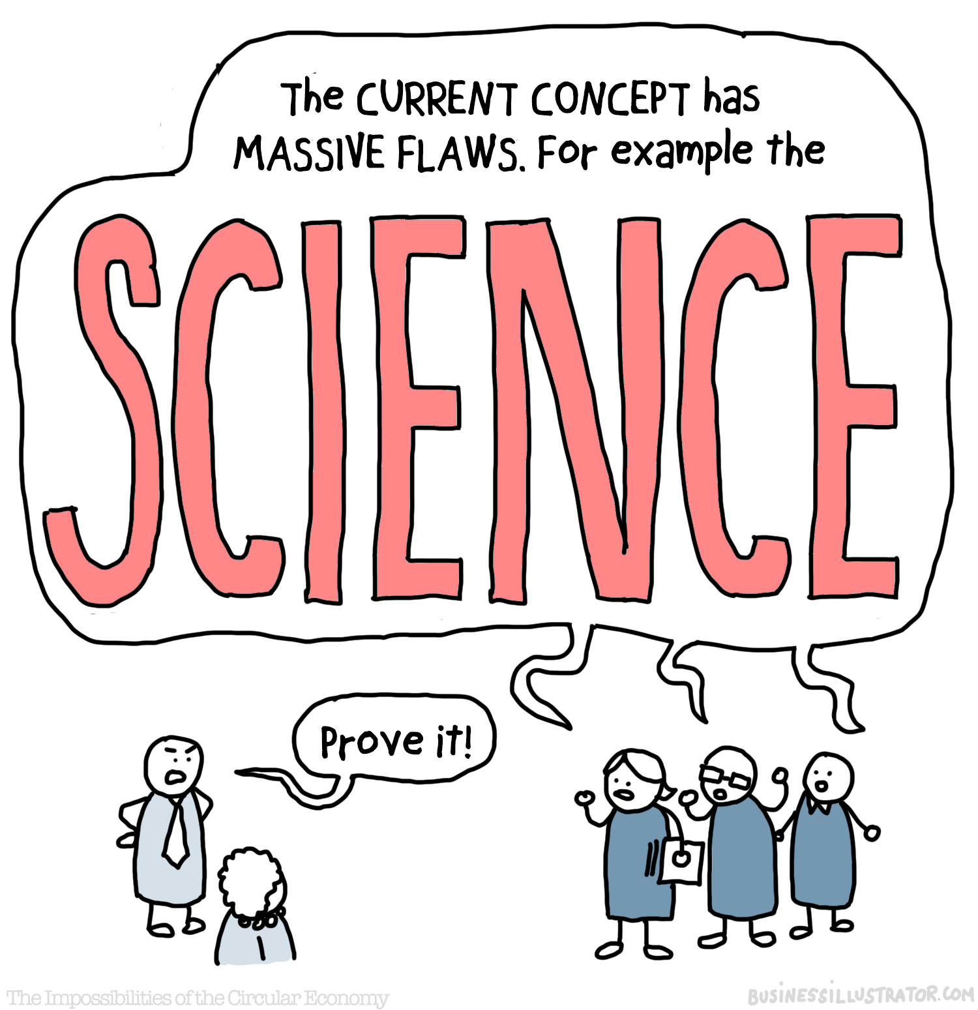

Slide 9
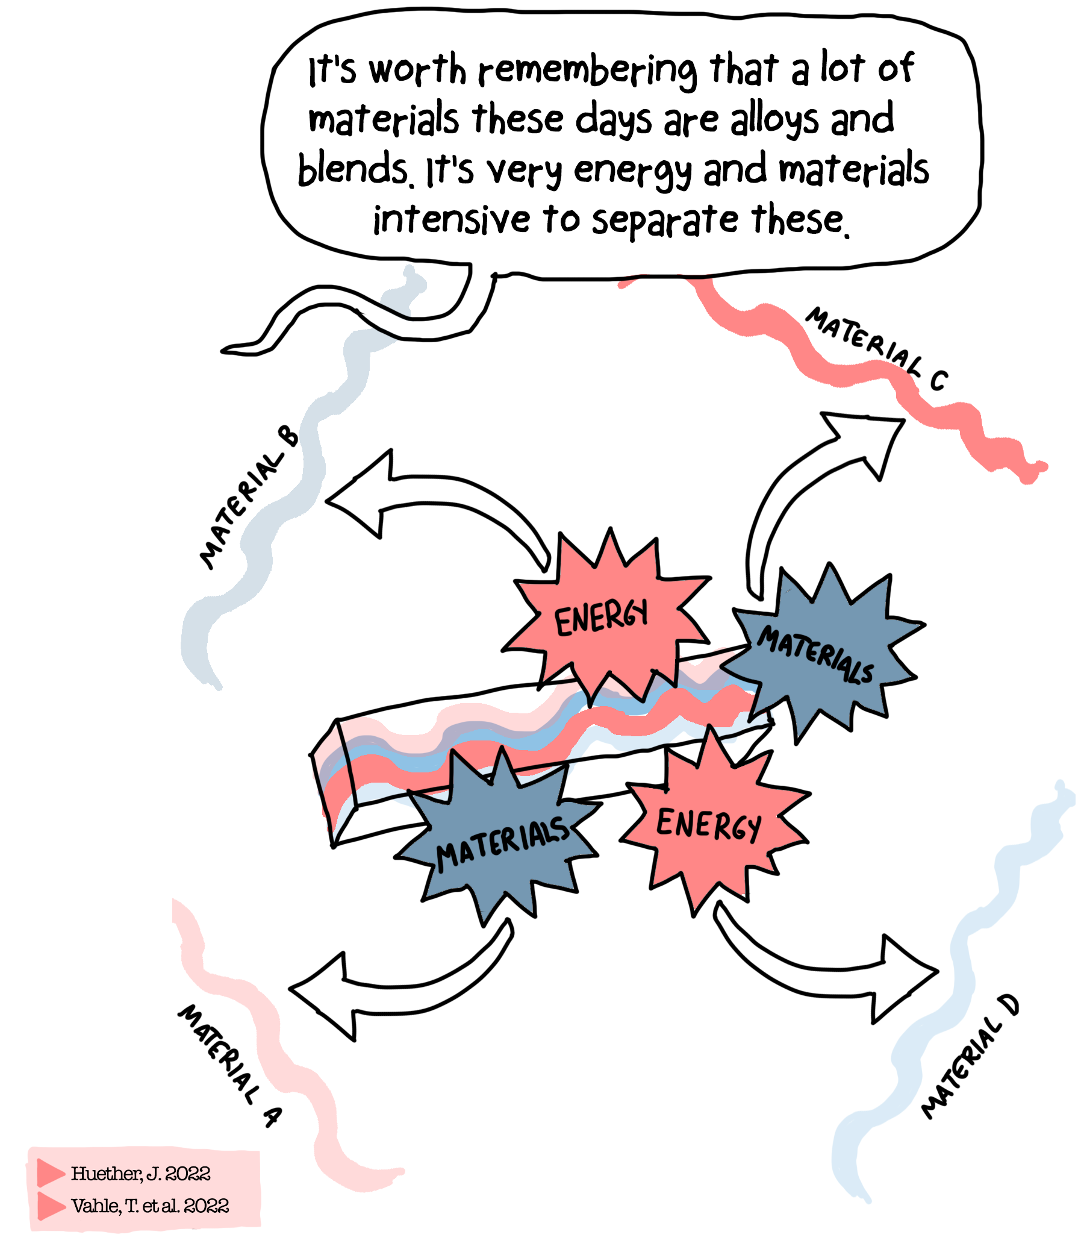

Slide 10
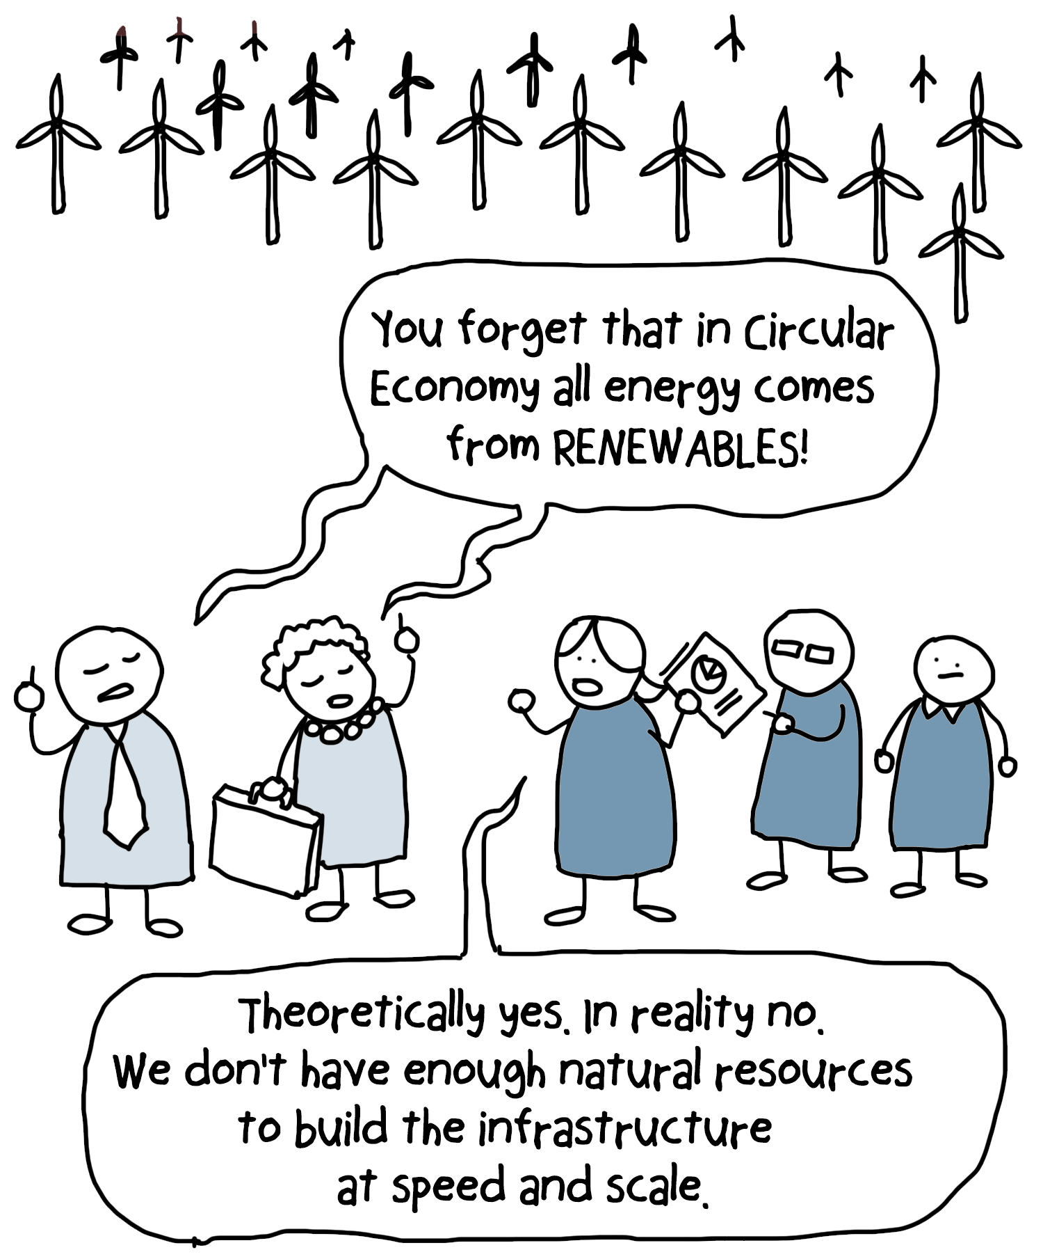

Slide 11
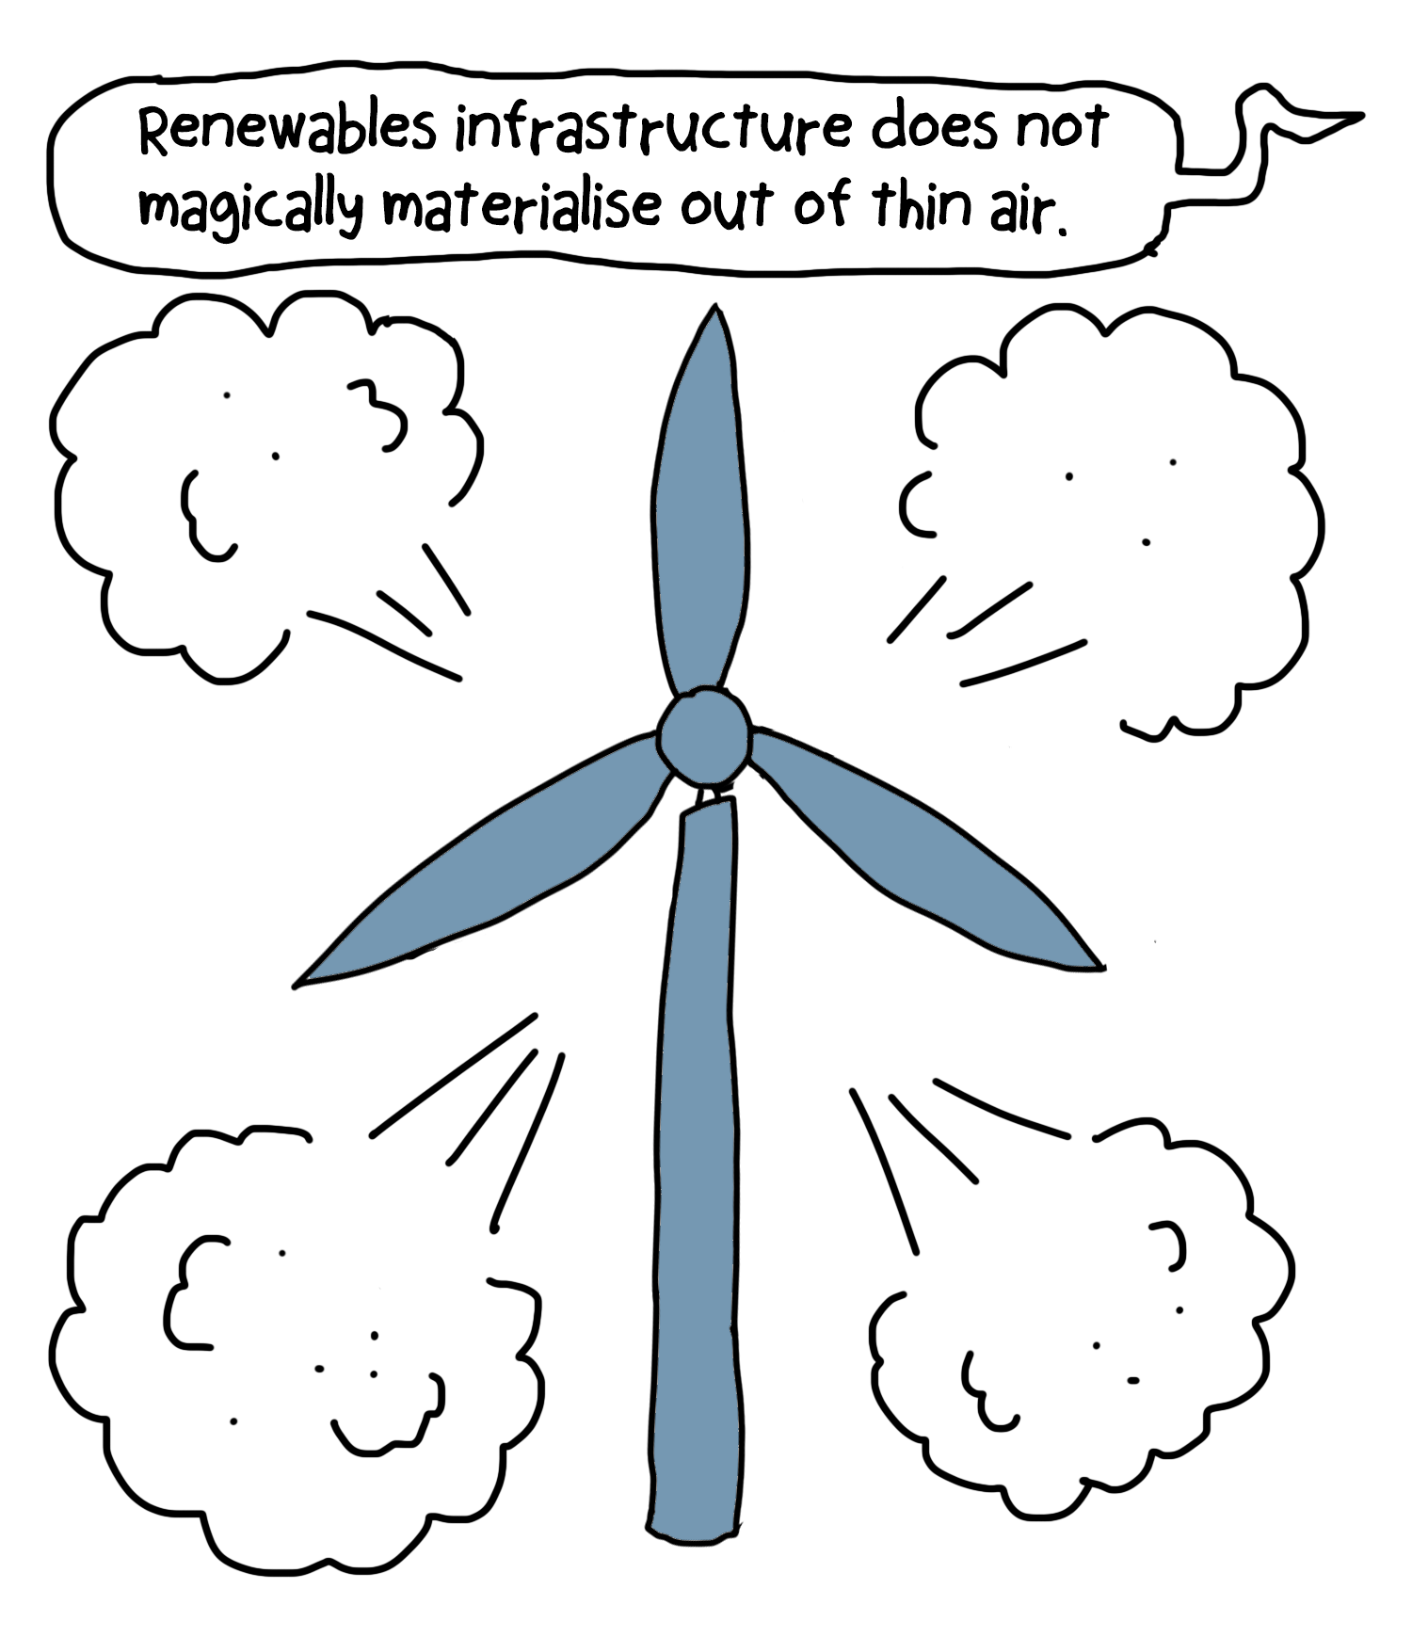

Slide 12
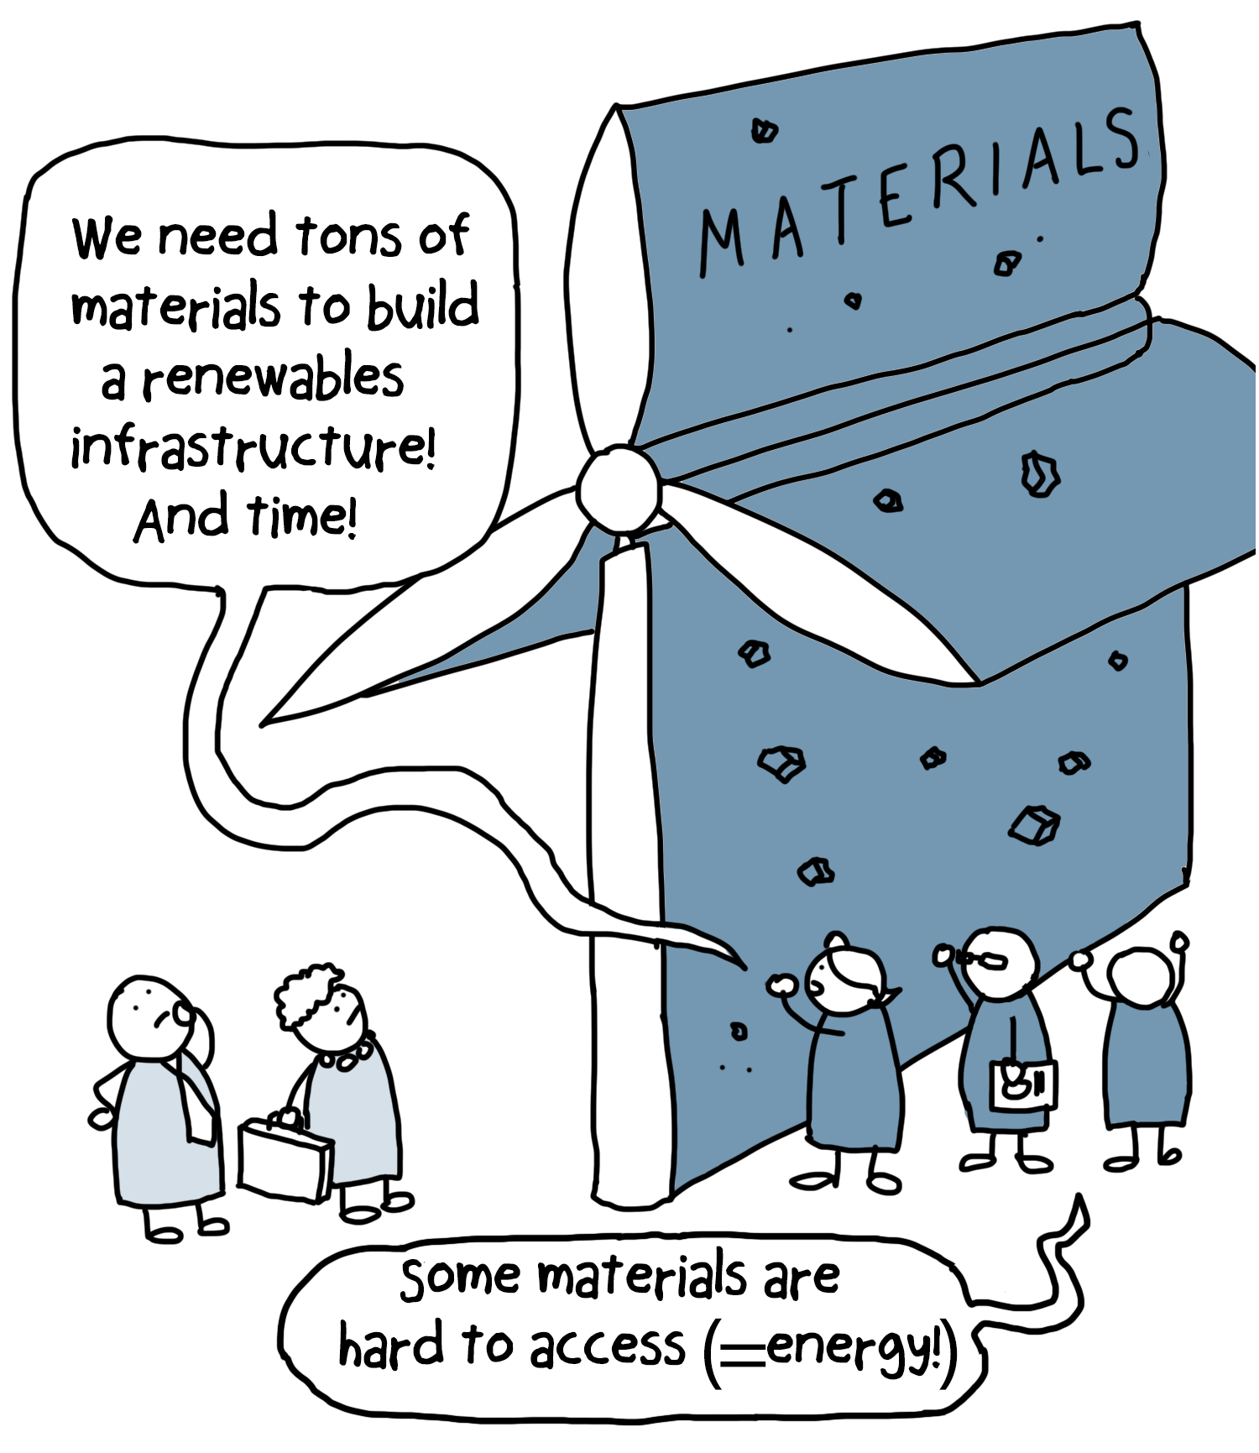

Slide 13
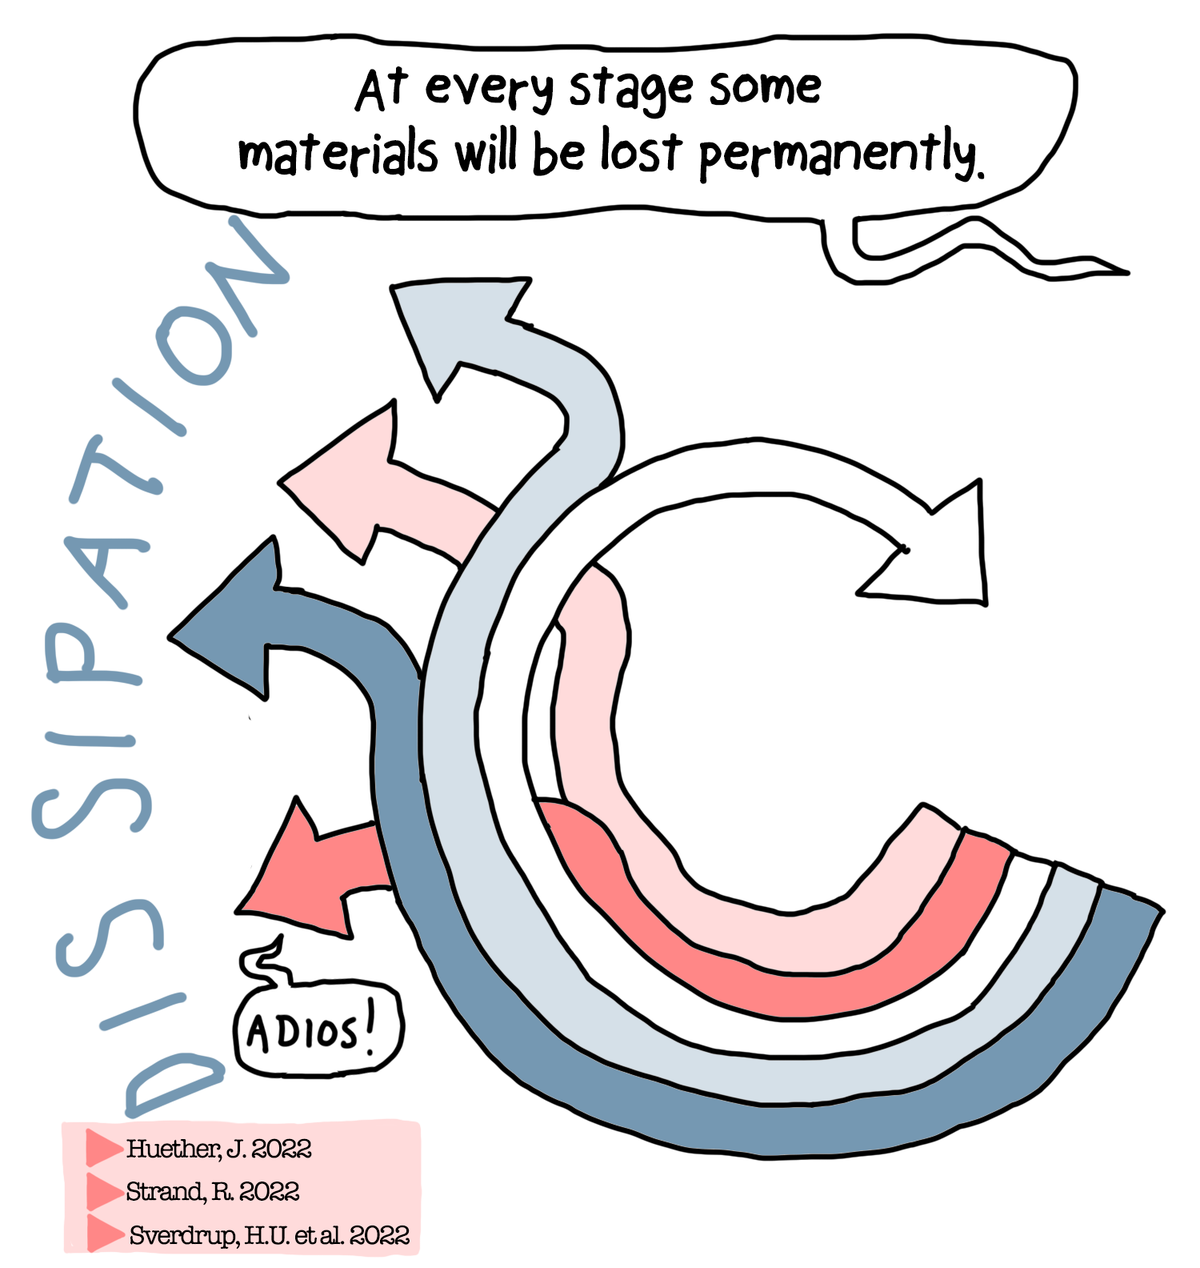

Slide 14
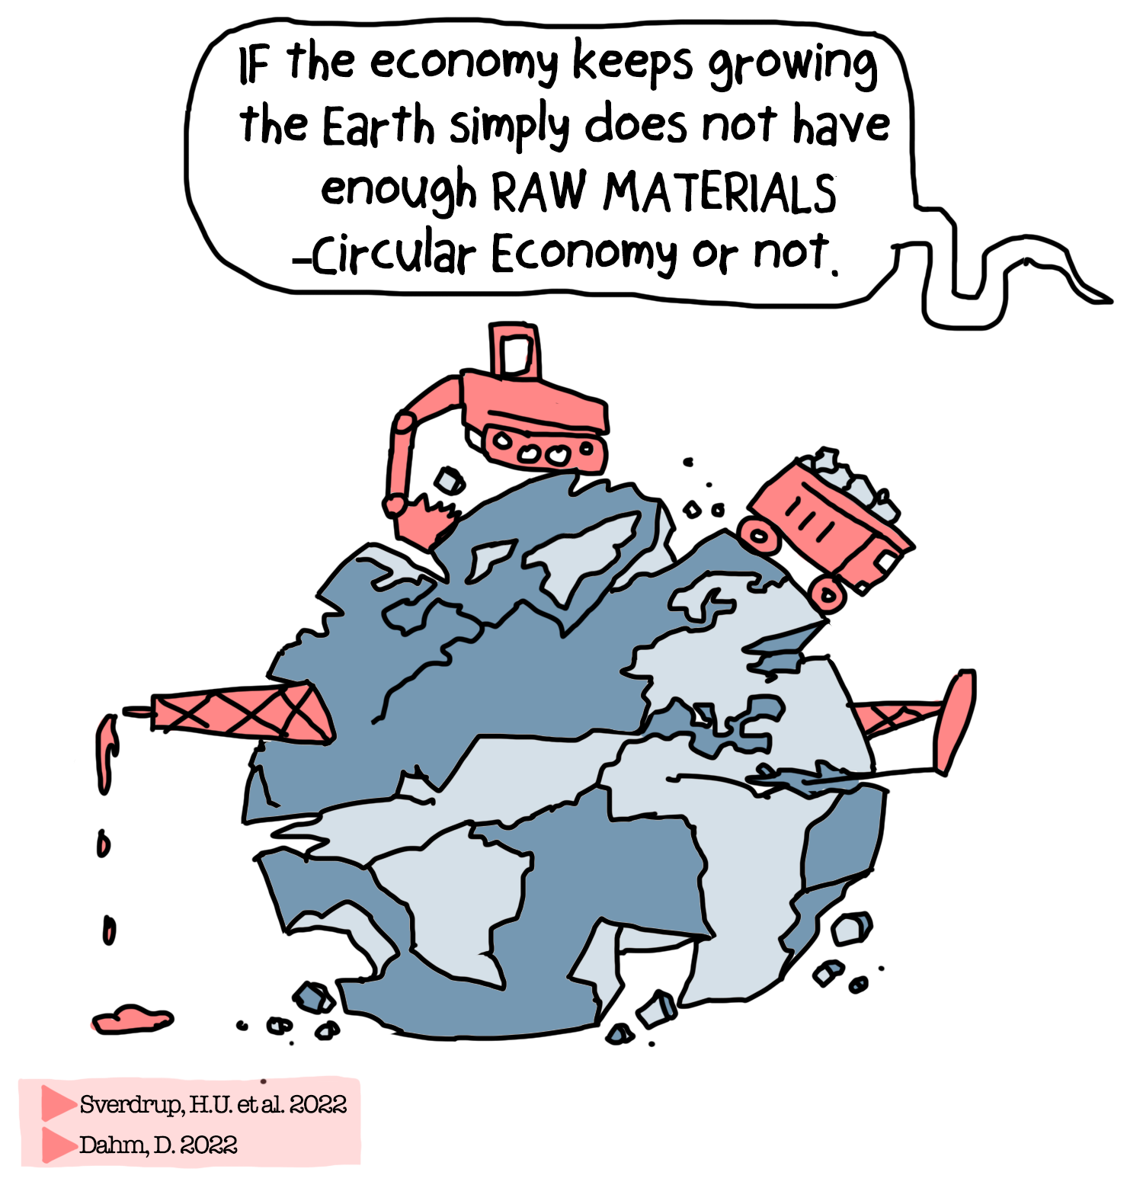

Slide 16
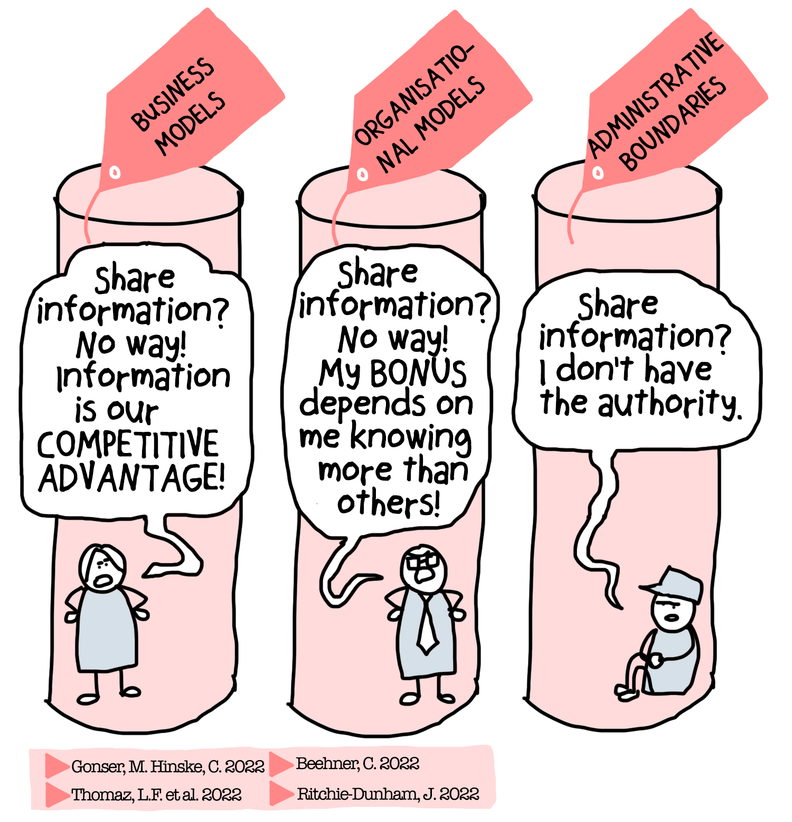

Slide 17
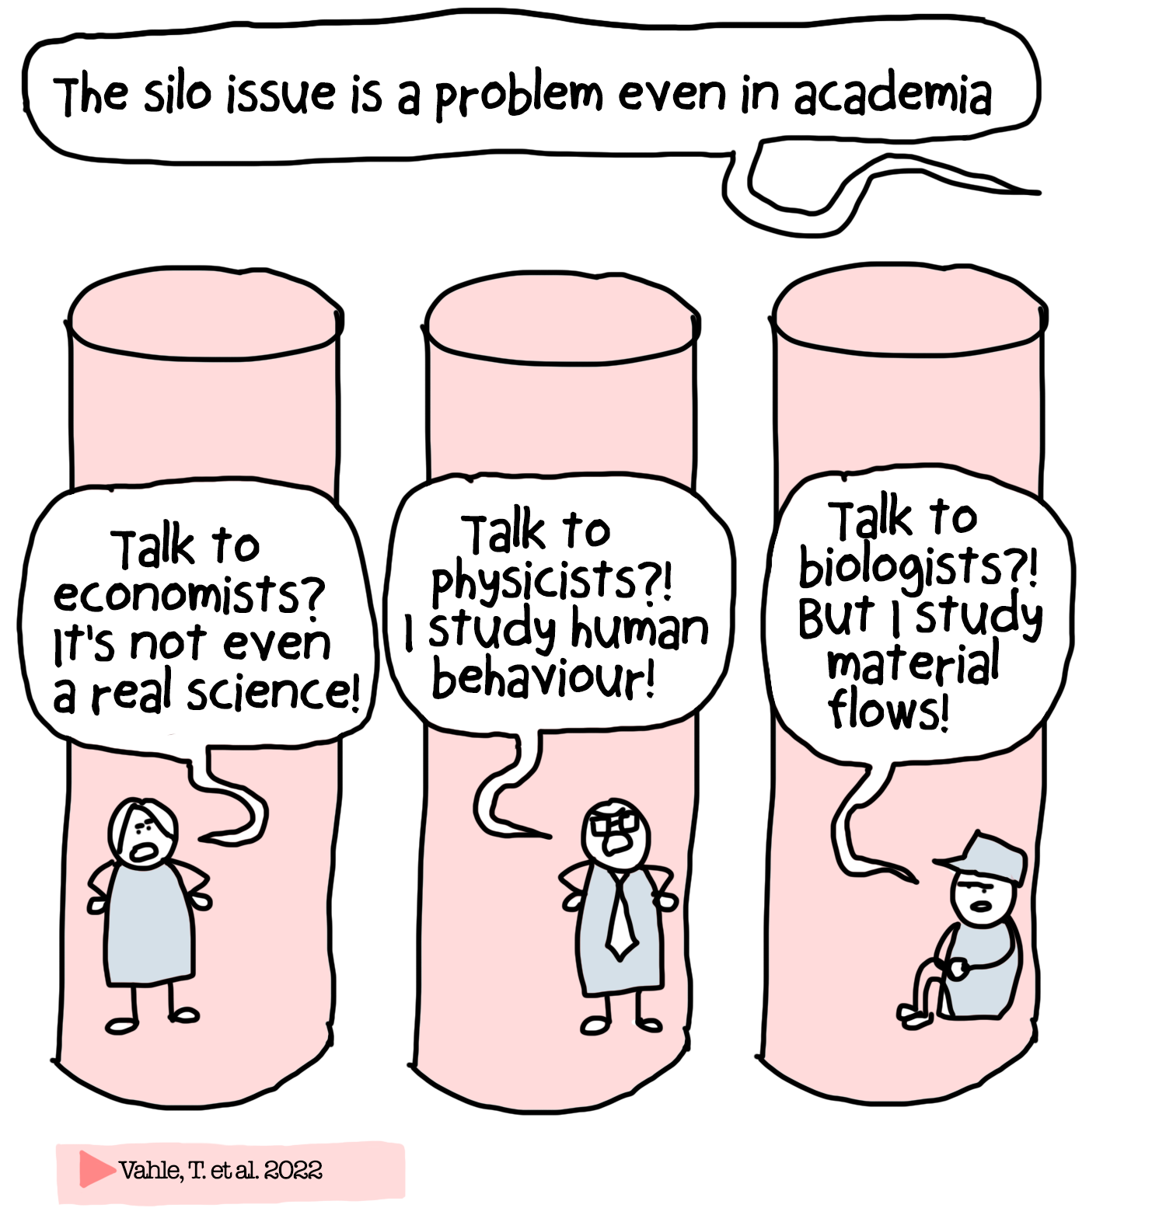

Slide 19
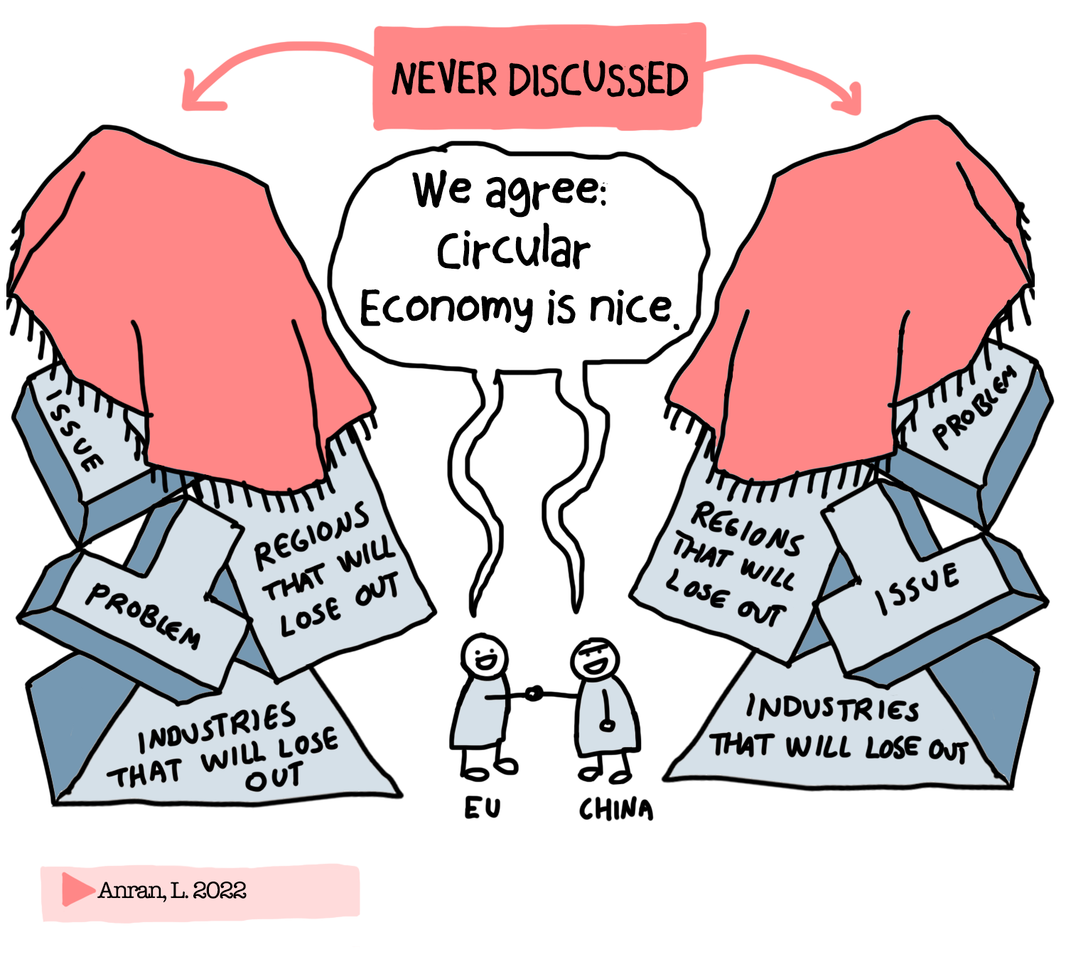

Slide 21
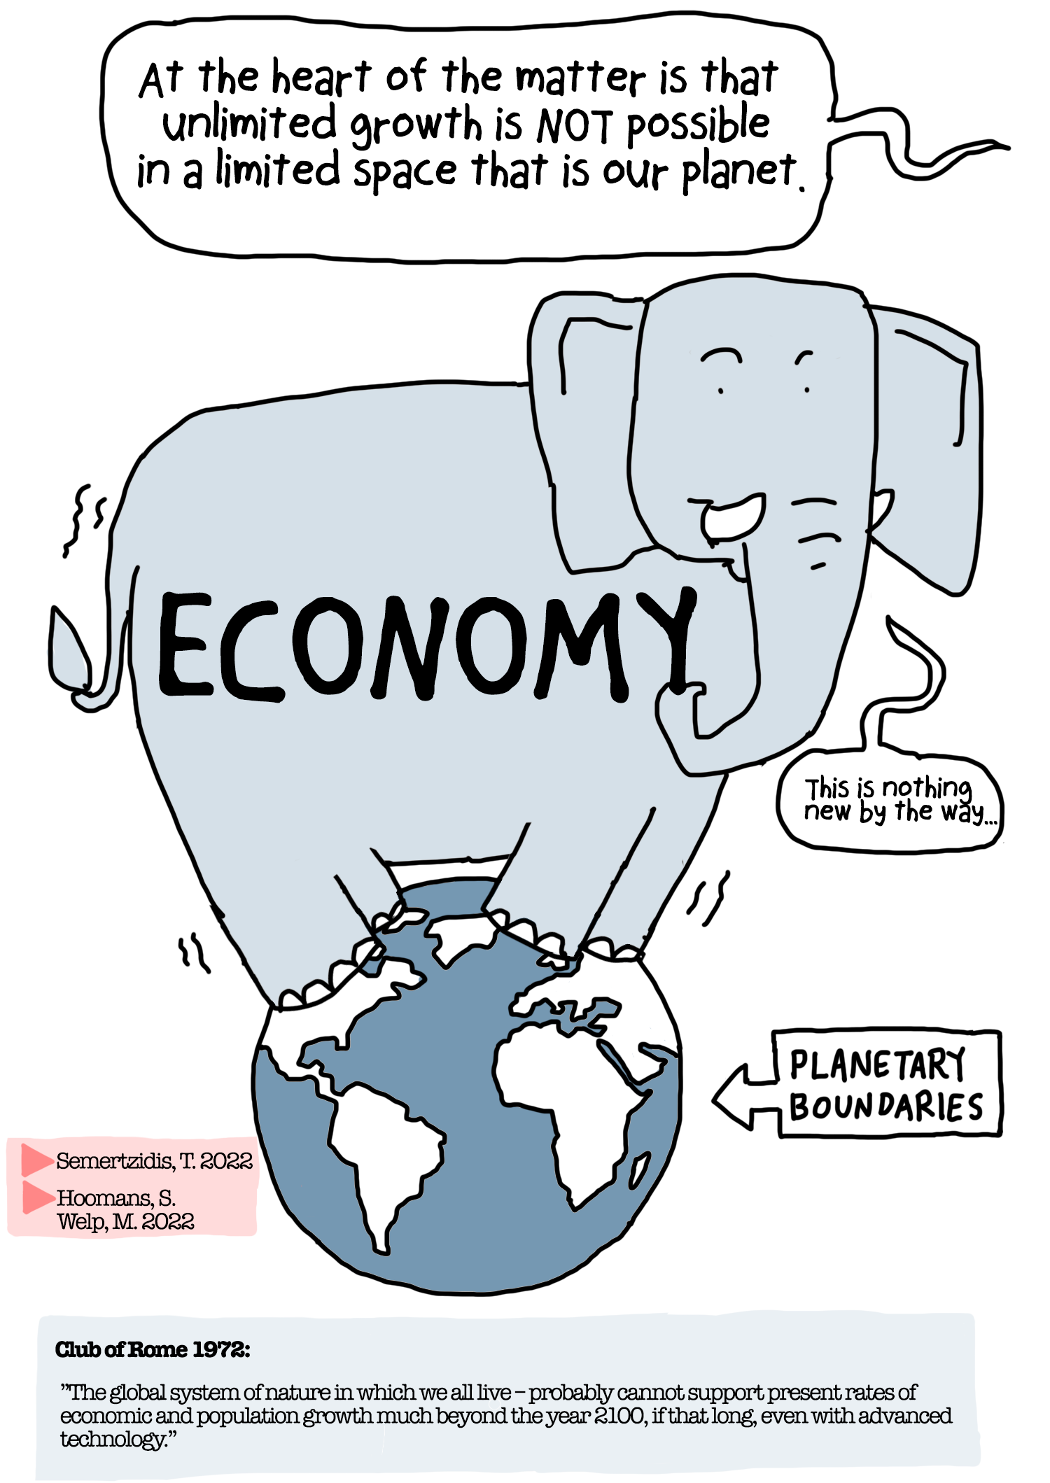

Slide 22
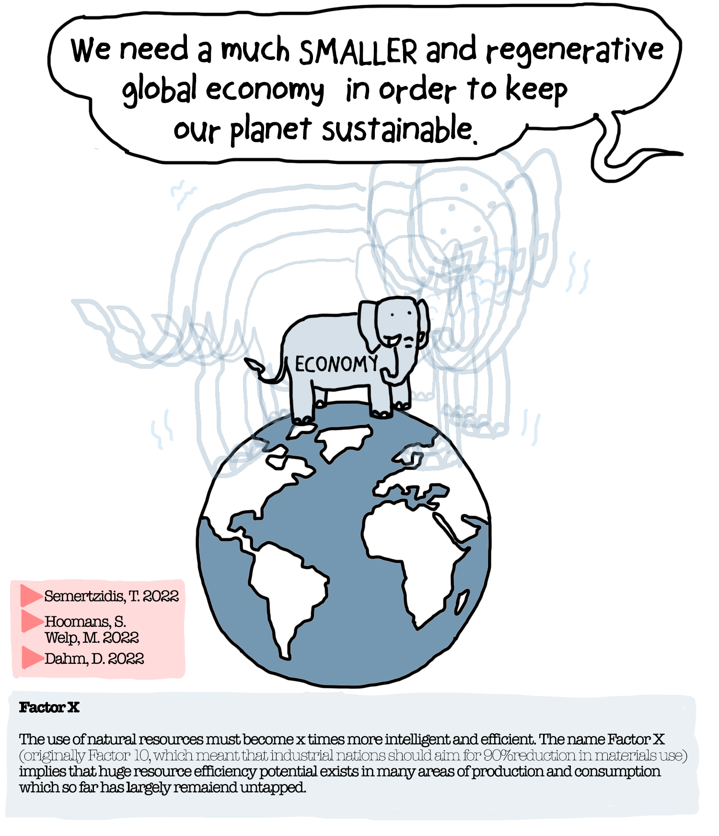

Slide 23
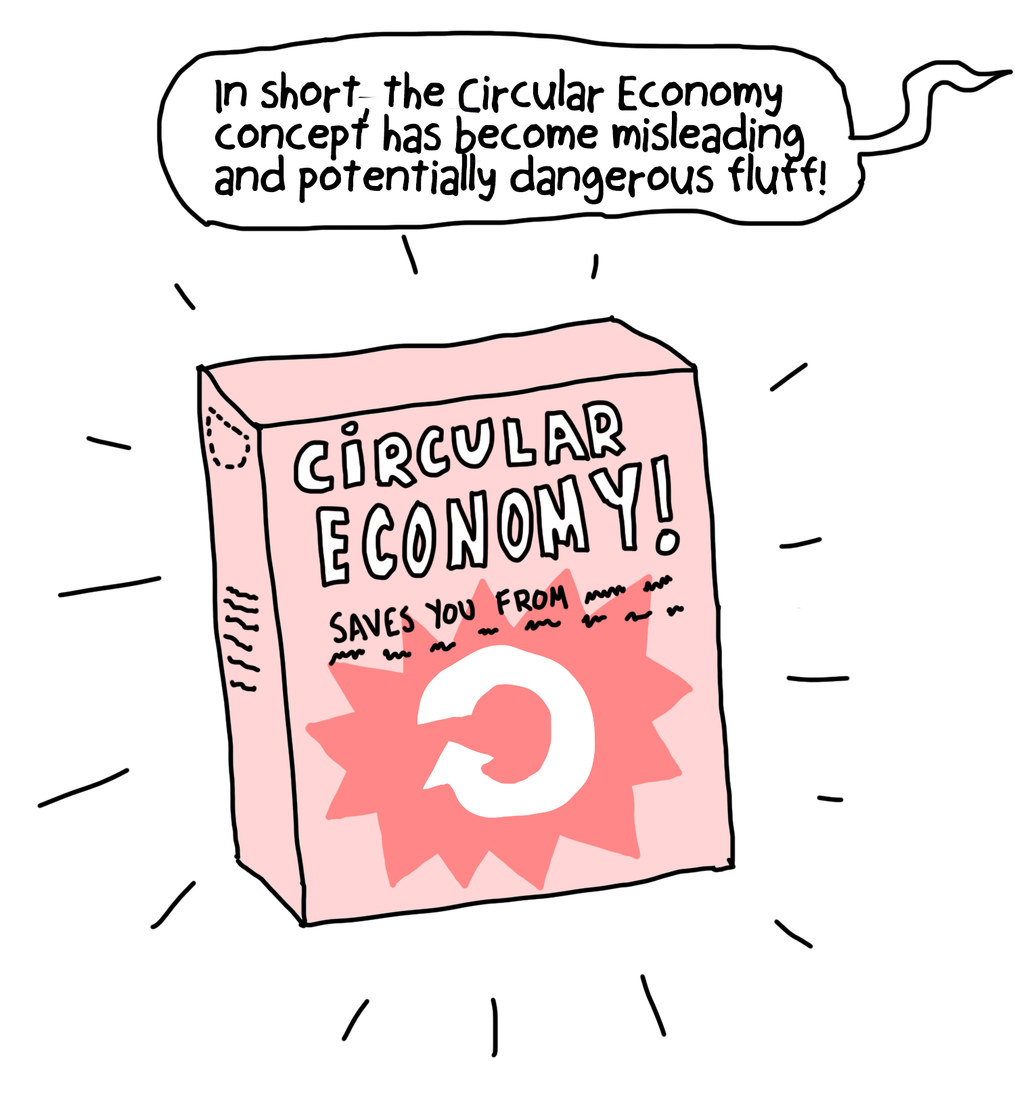

Slide 24
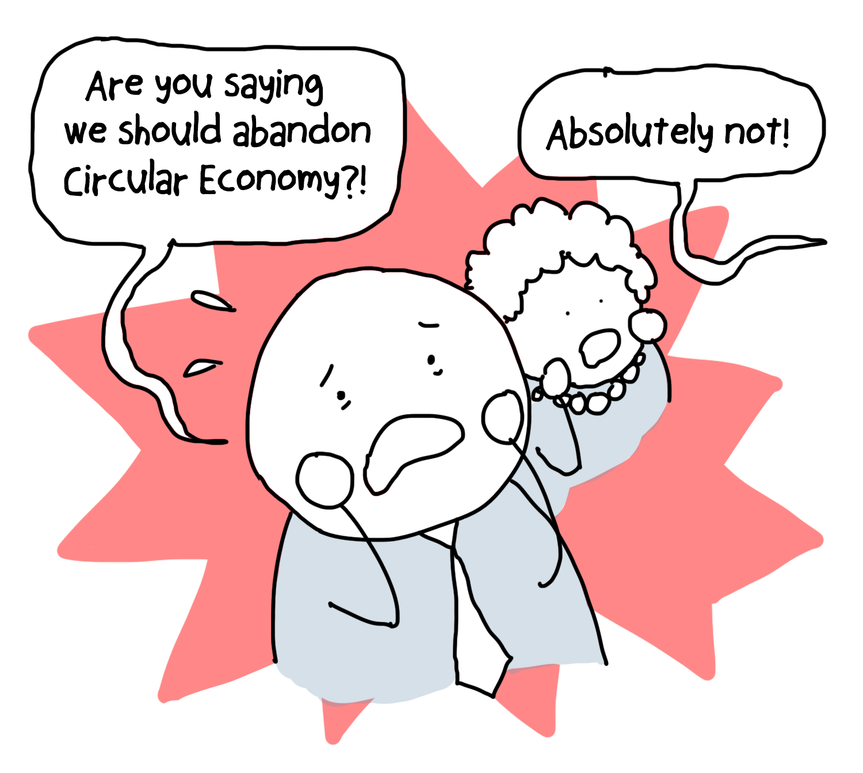

Slide 25
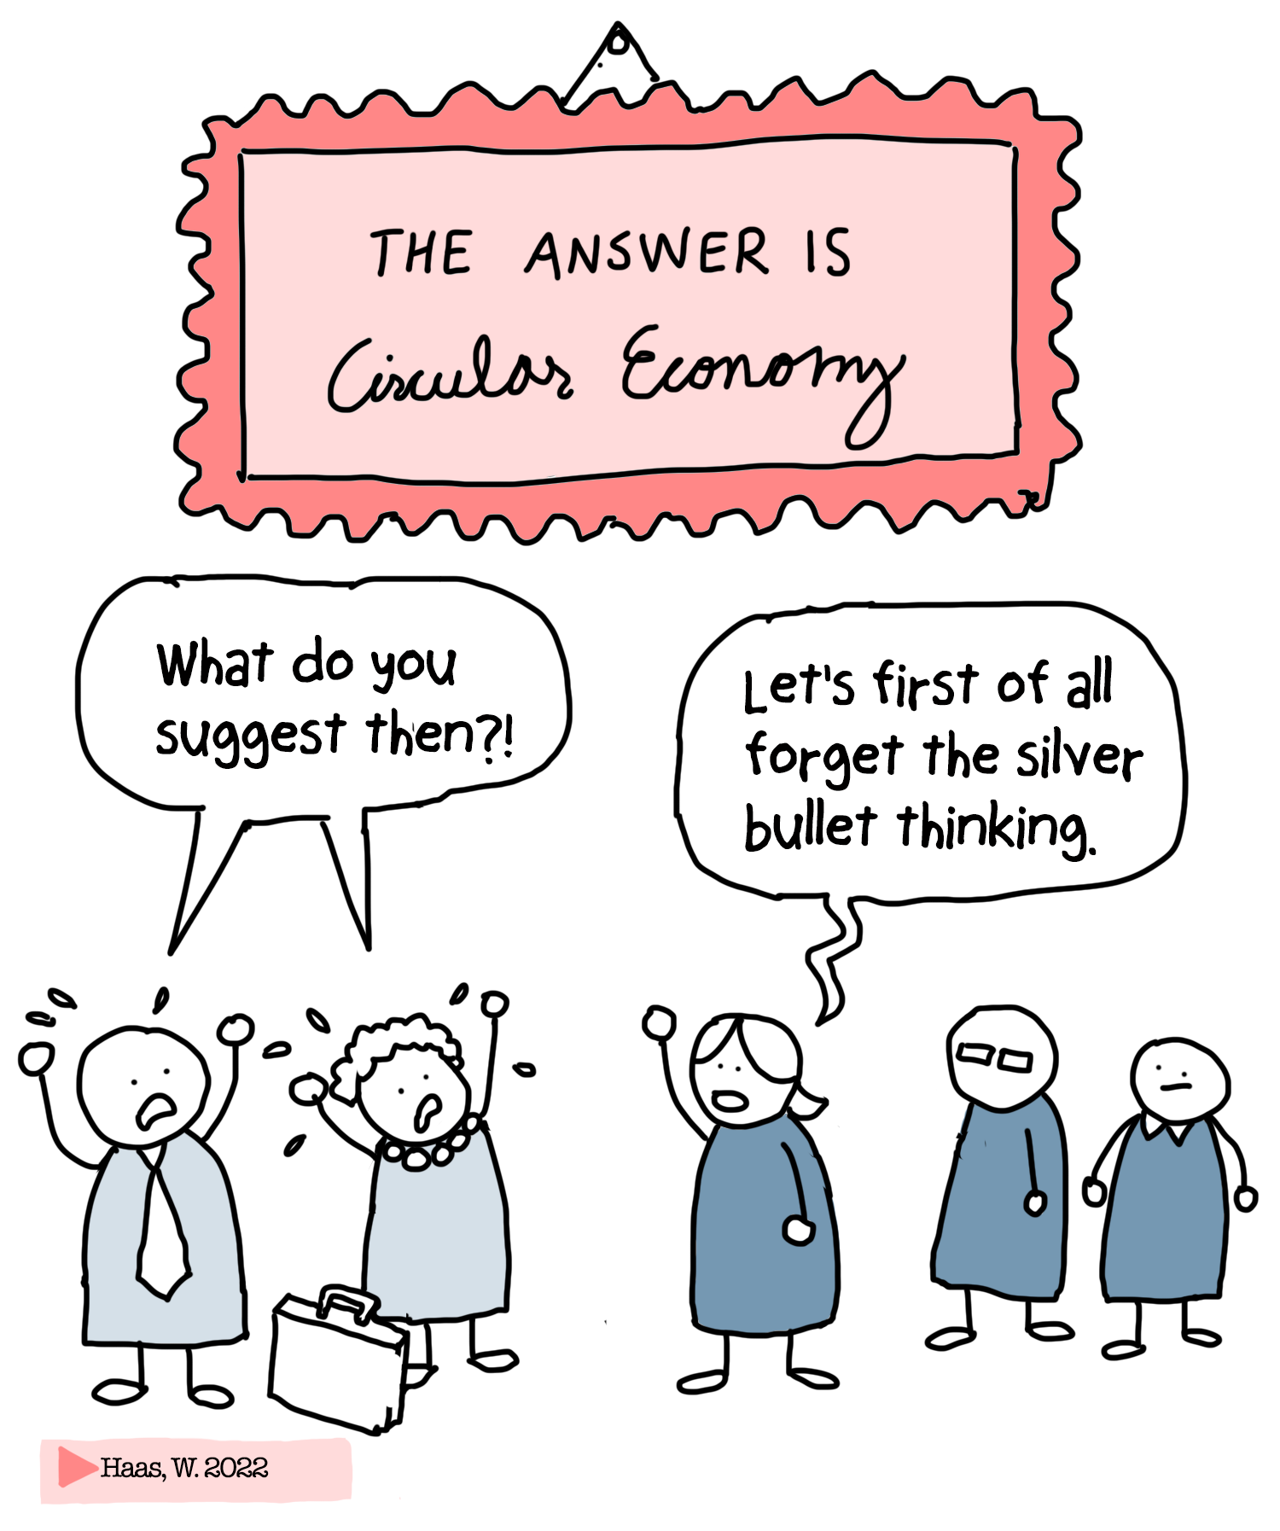

Slide 26
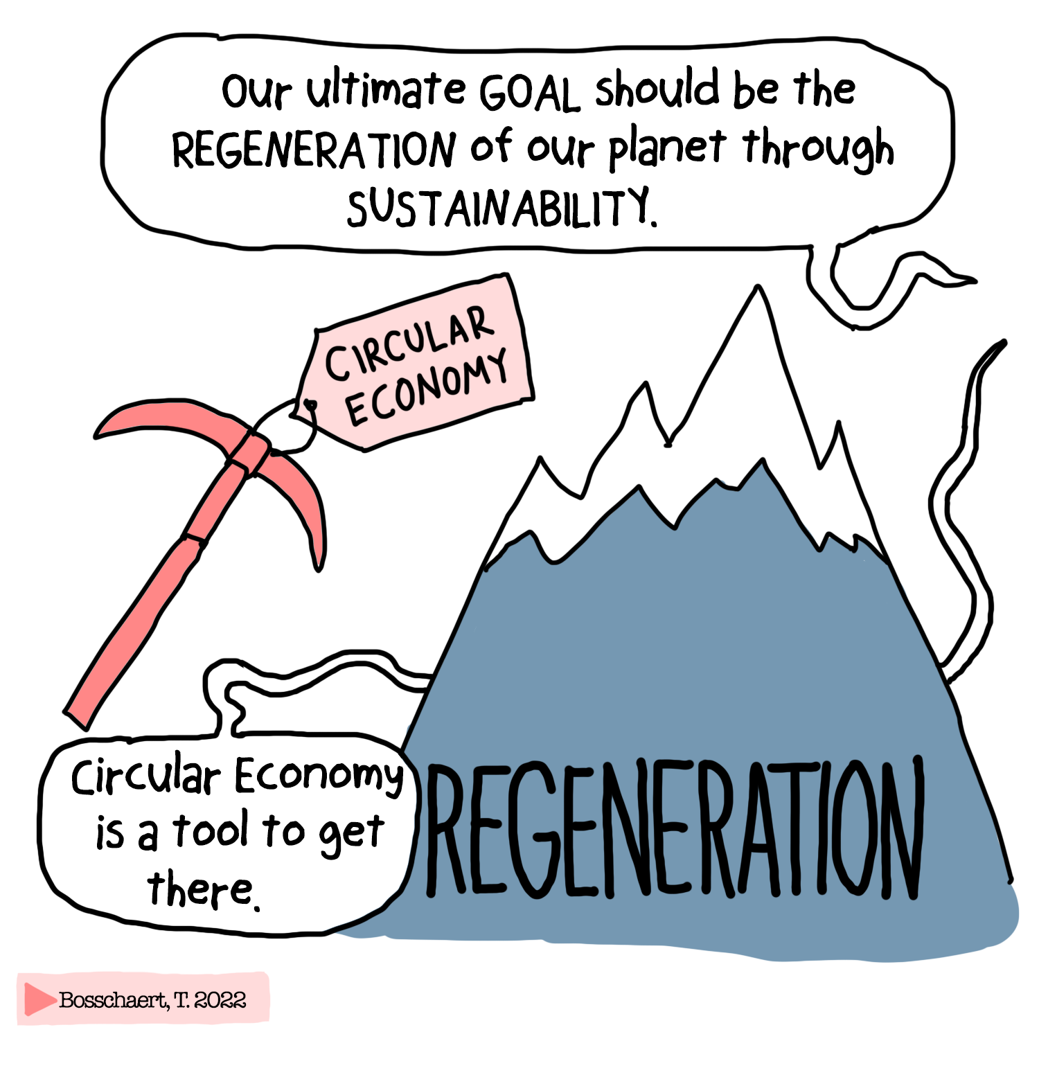

Slide 27
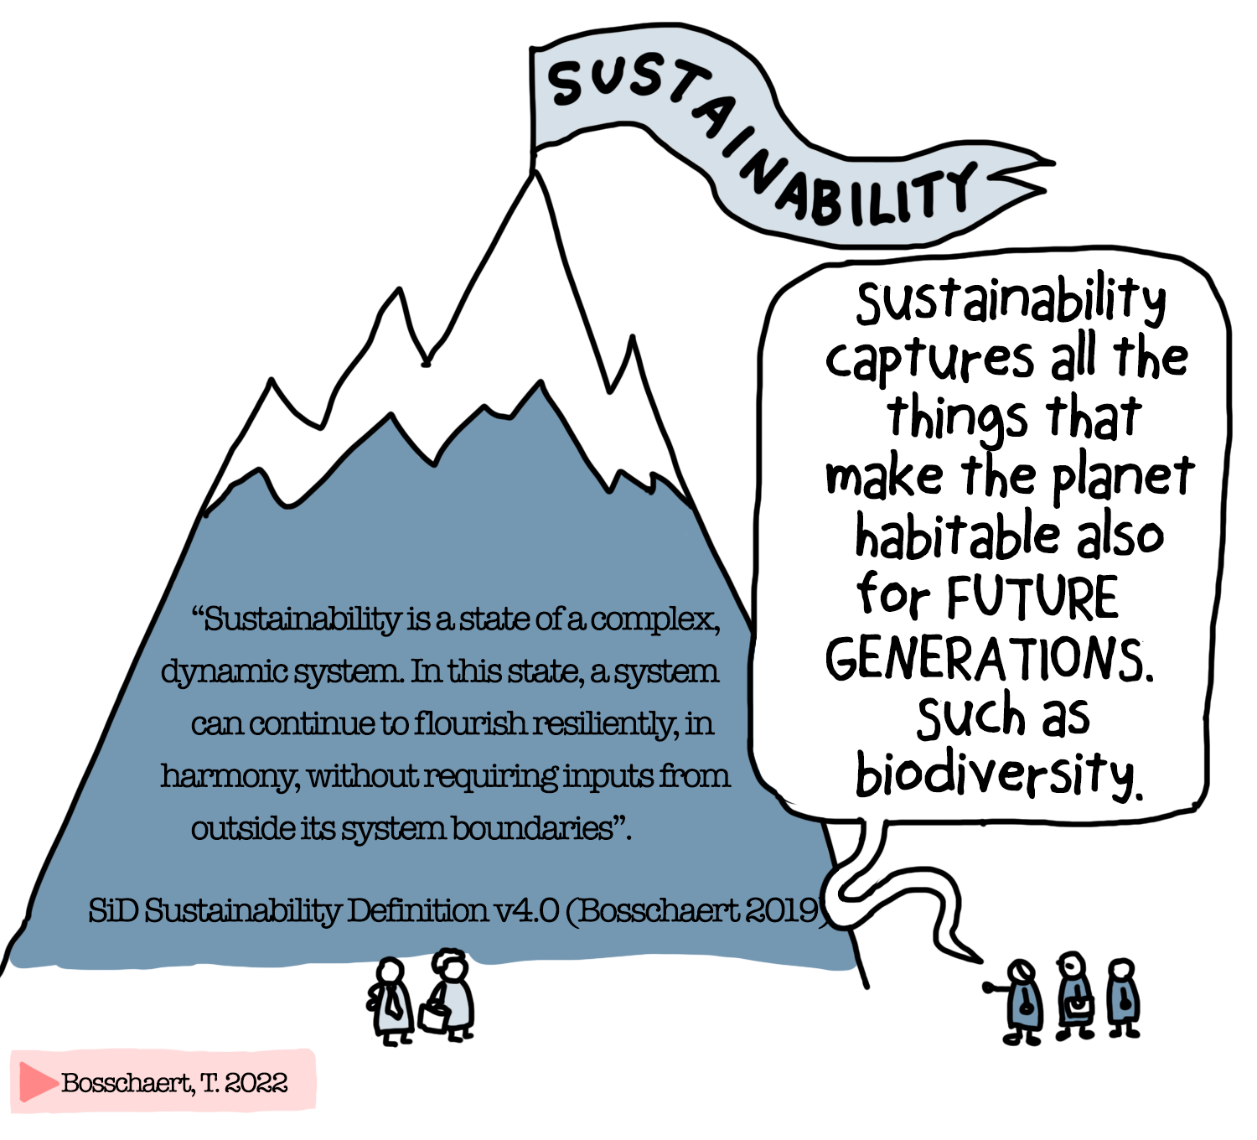

Slide 28
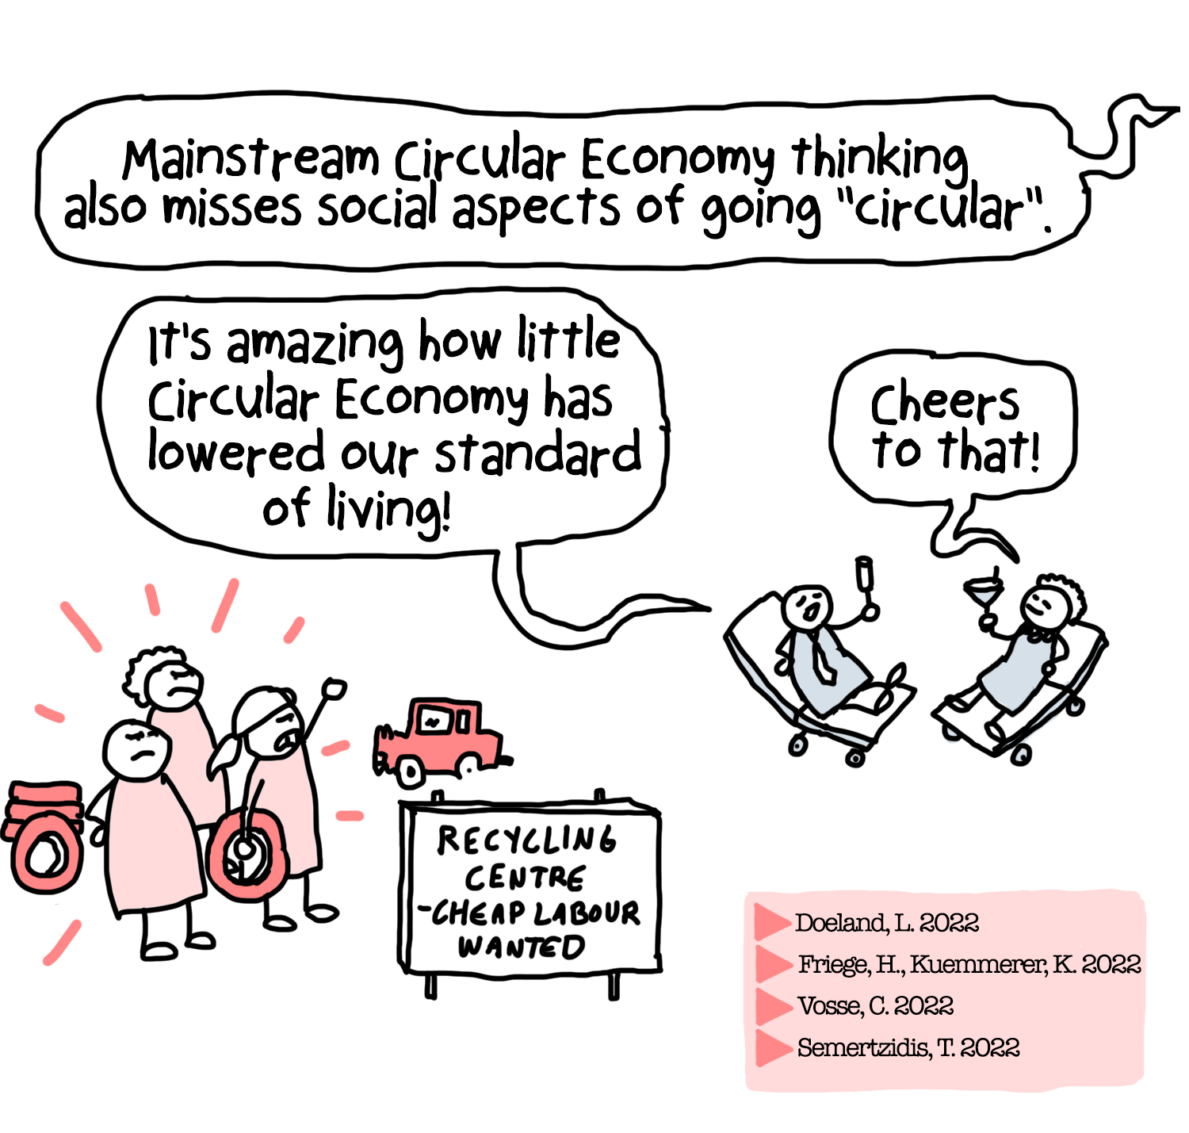

Slide 29
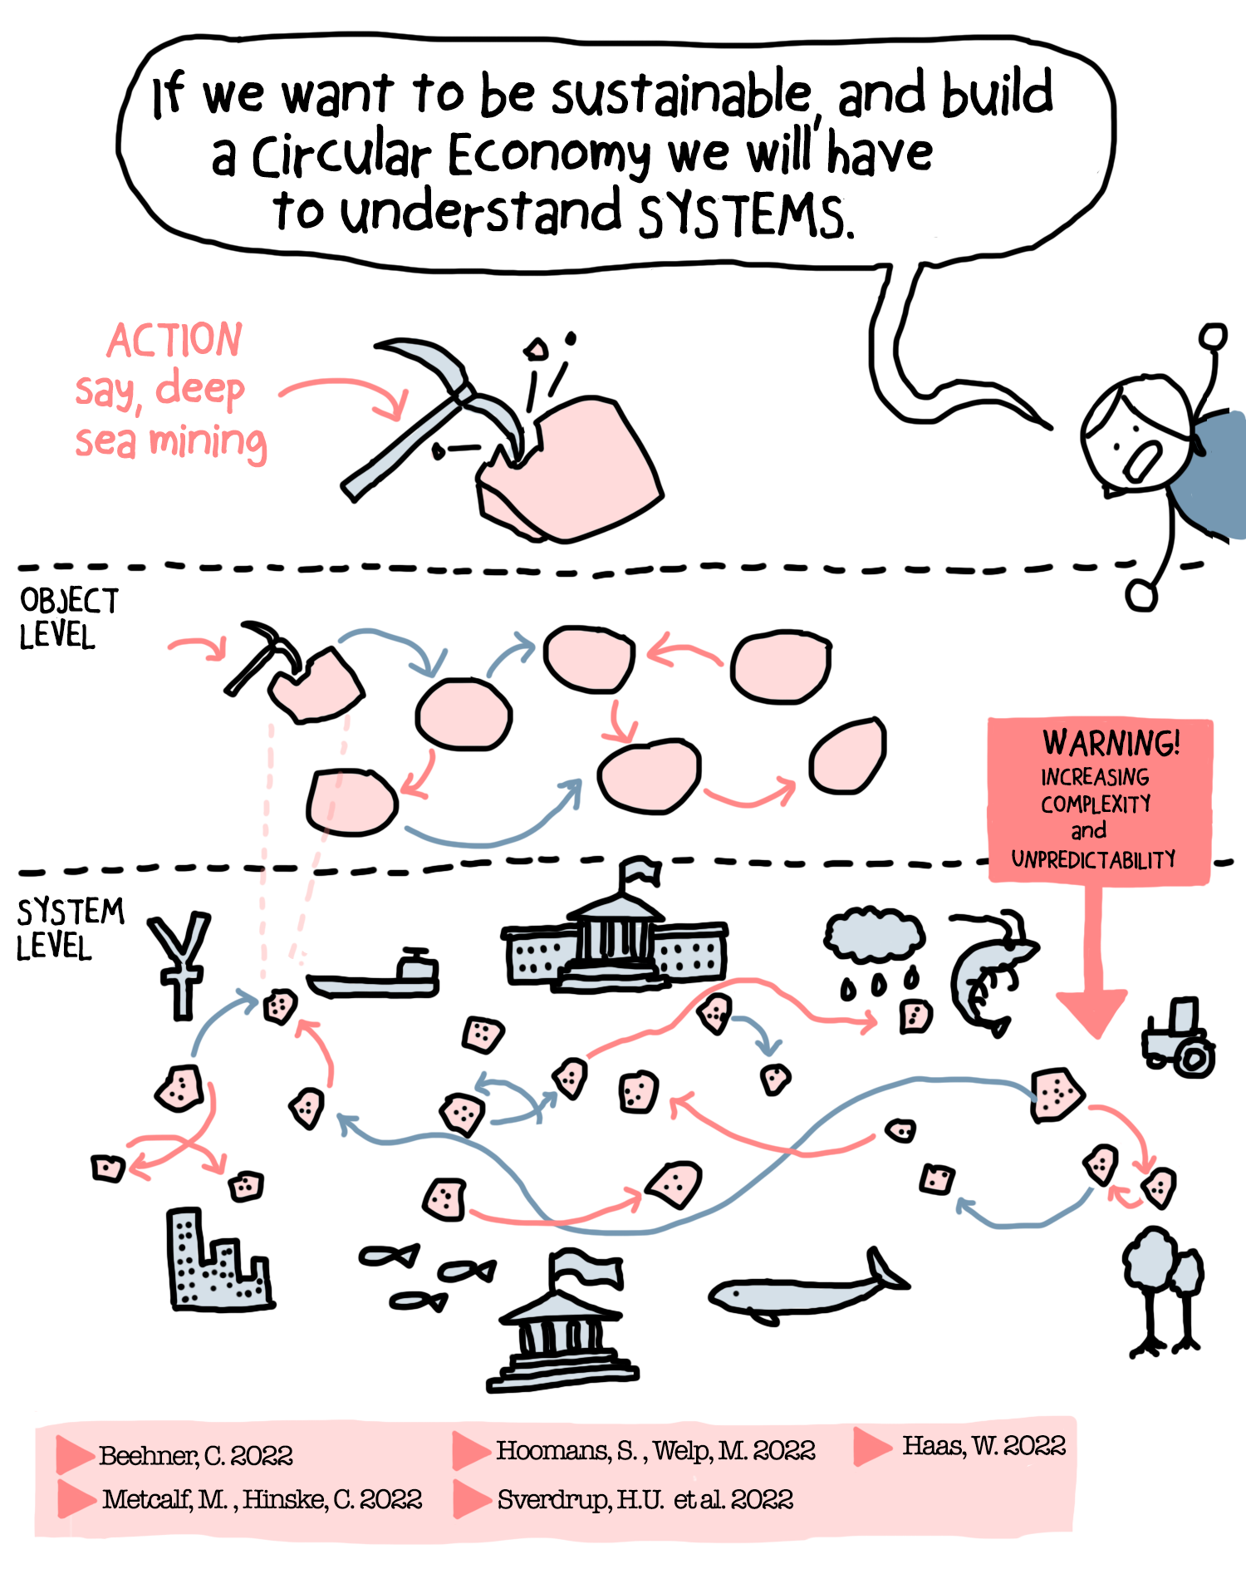

Slide 30
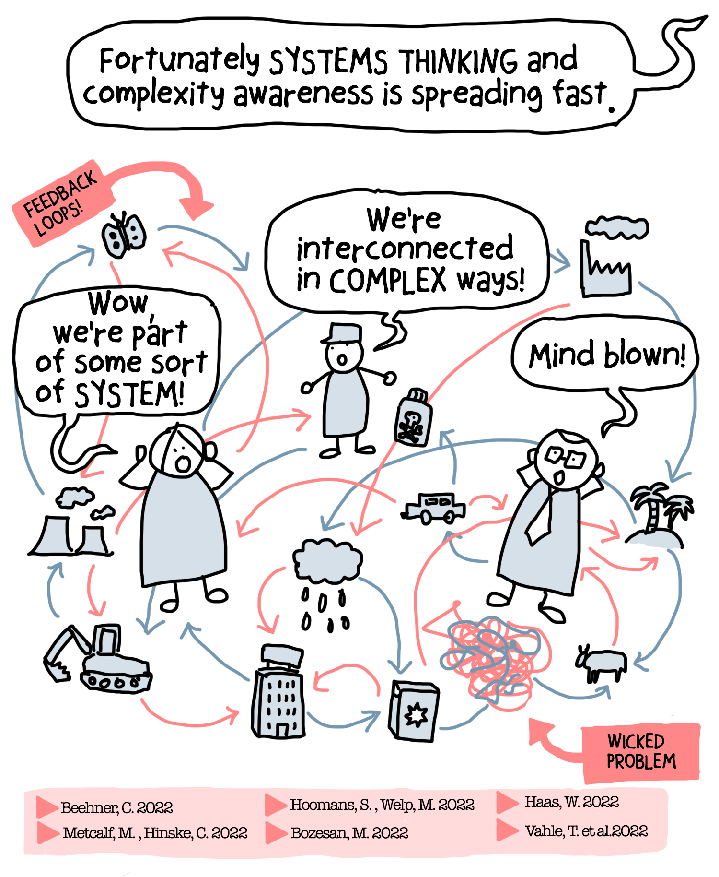

Slide 31
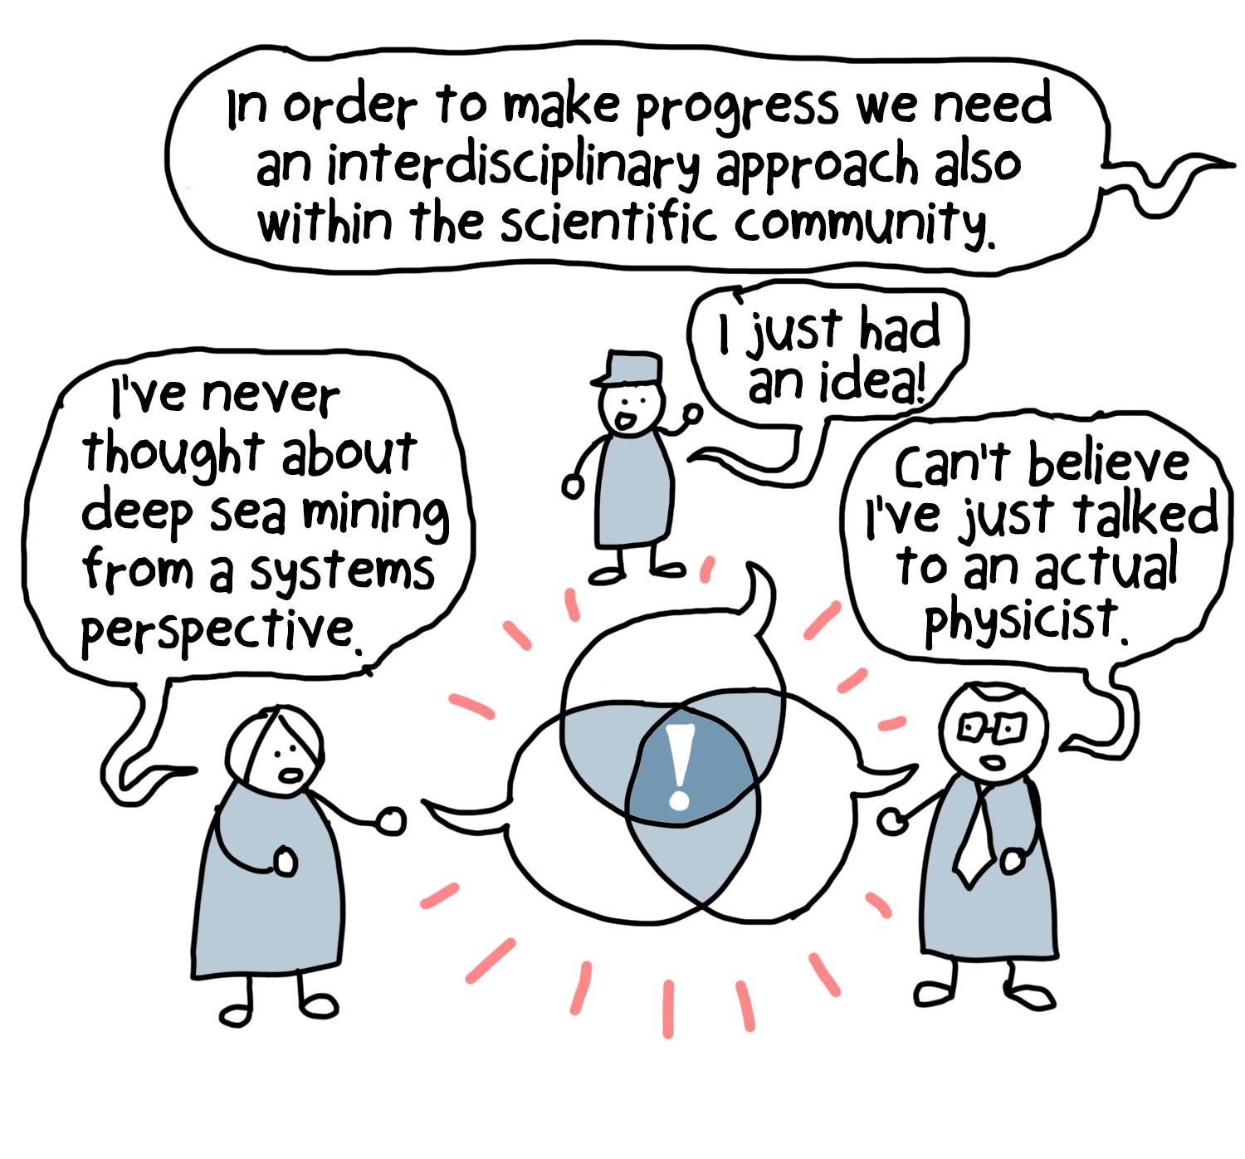

Slide 32
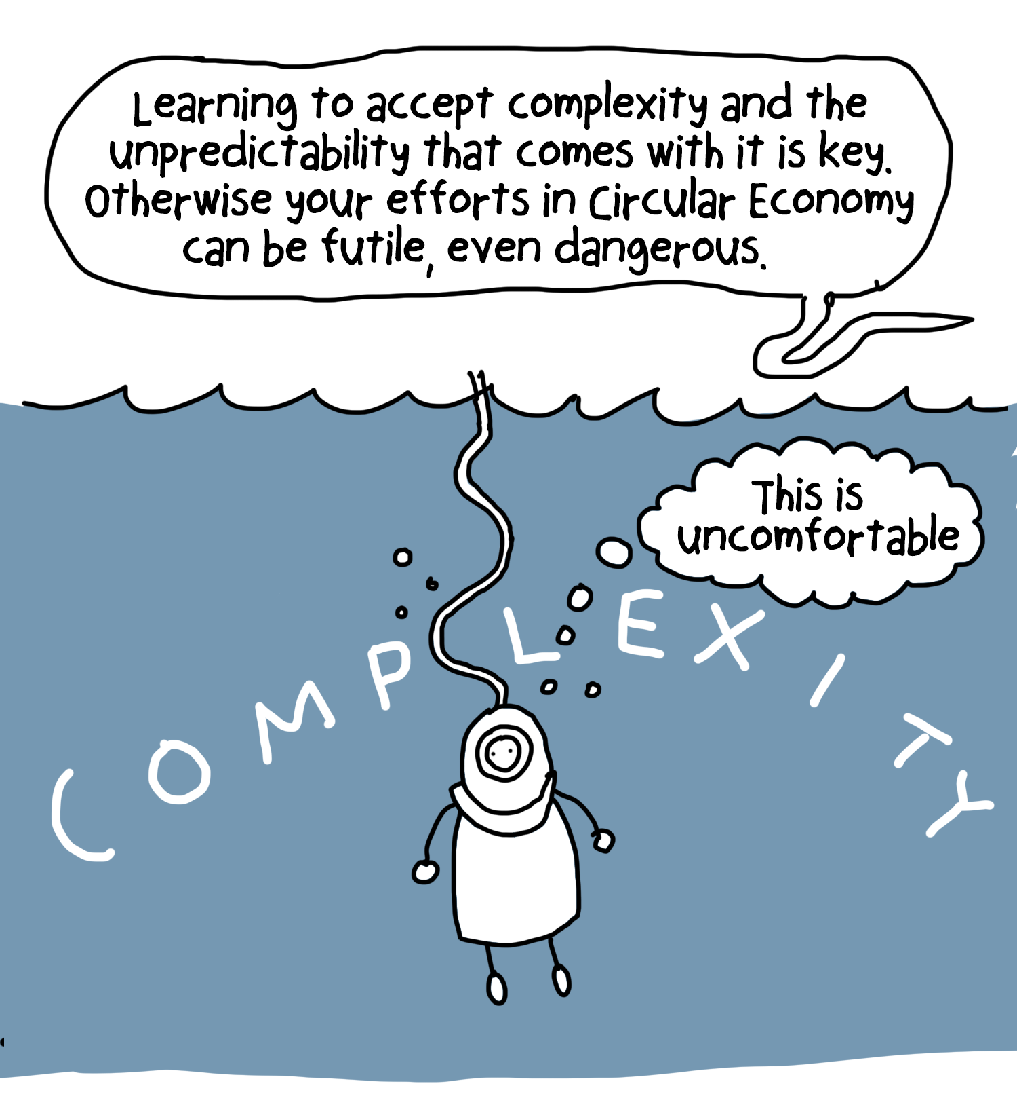

Slide 33
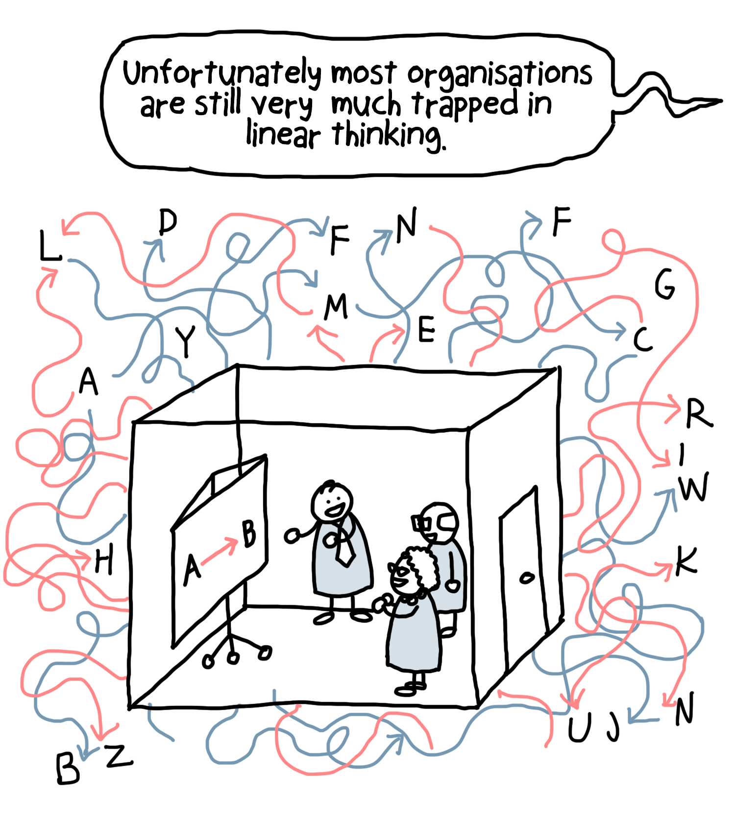

Slide 34
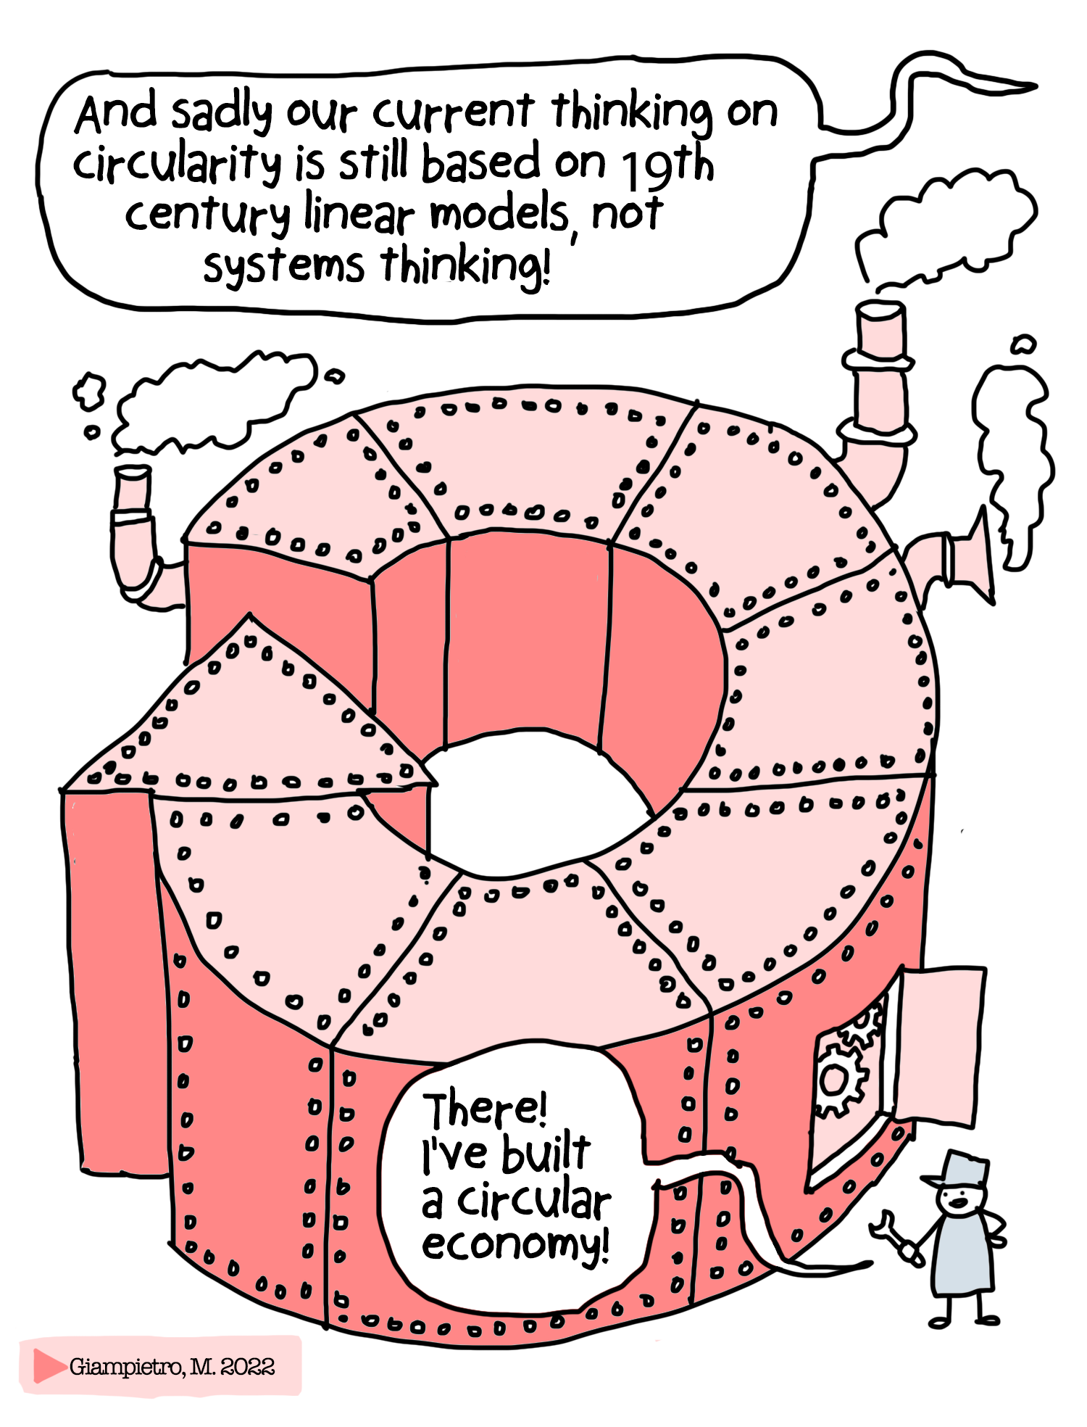

Slide 35
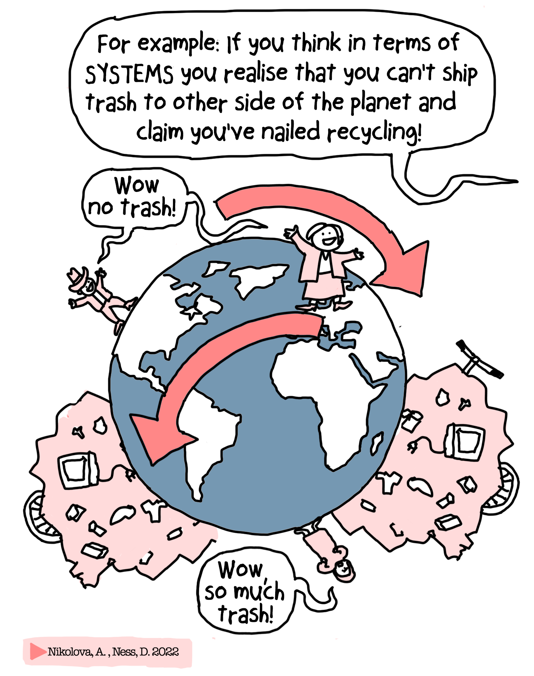

Slide 36
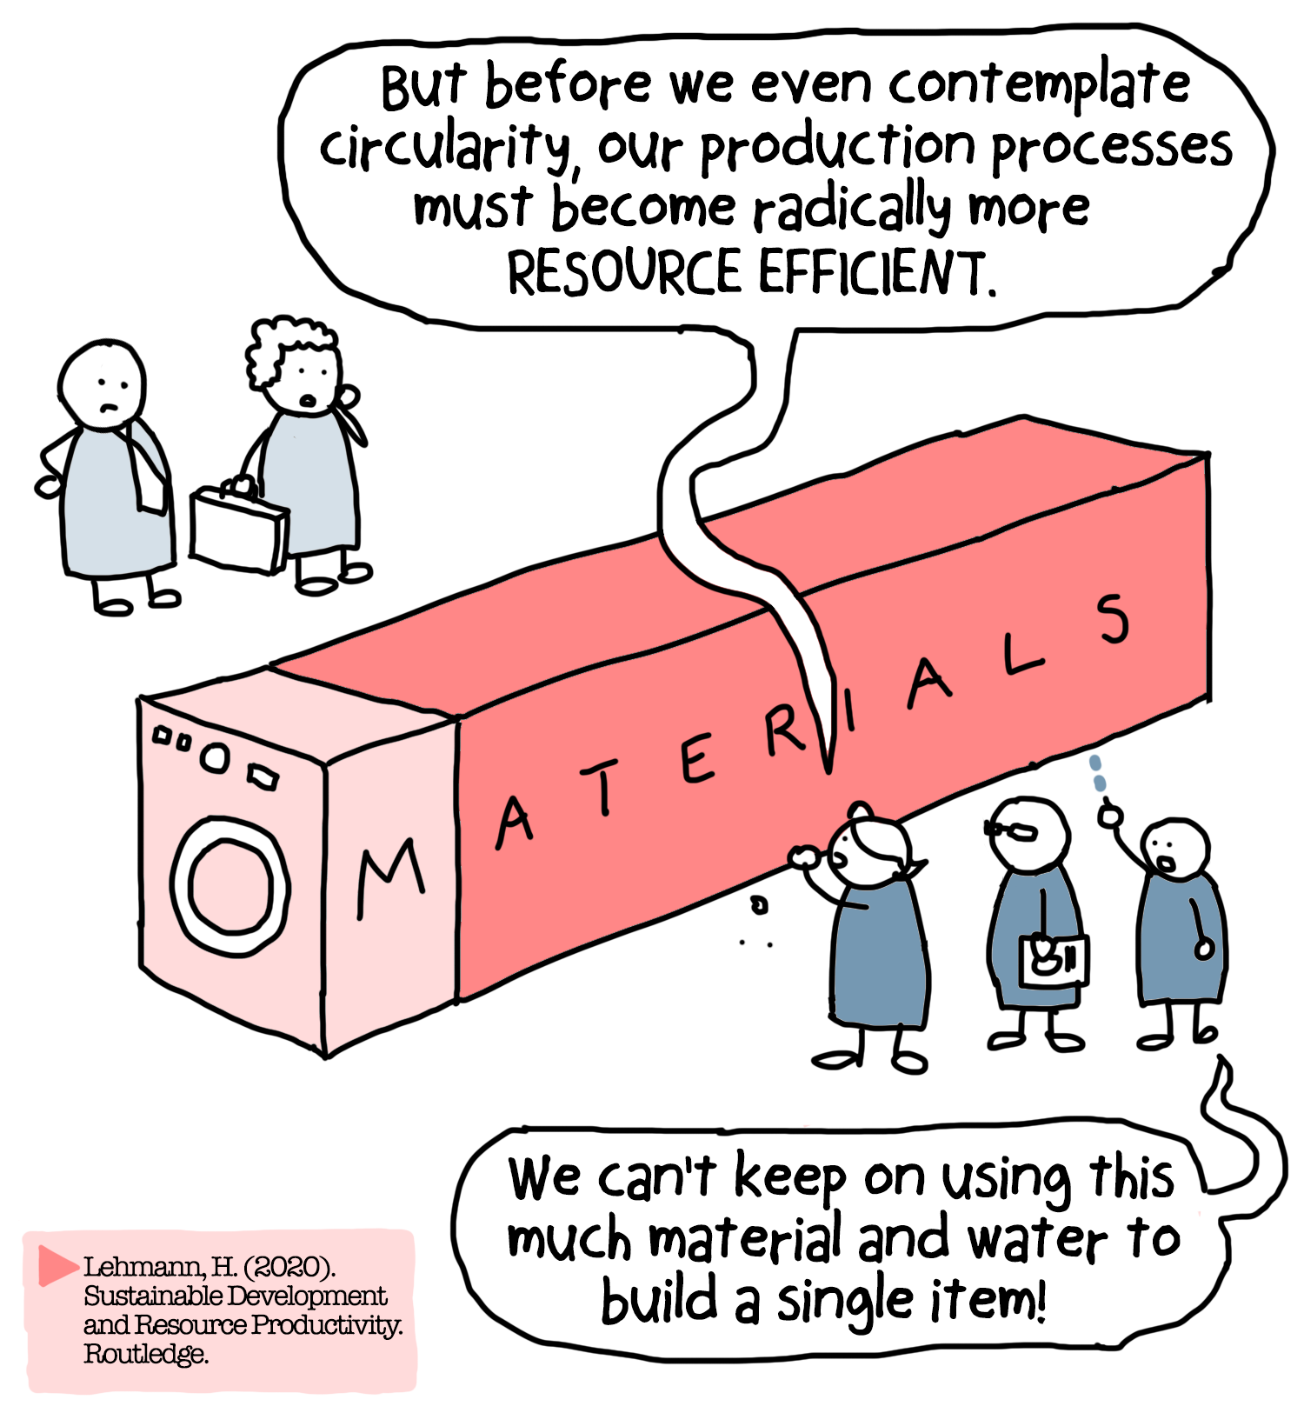

Slide 37
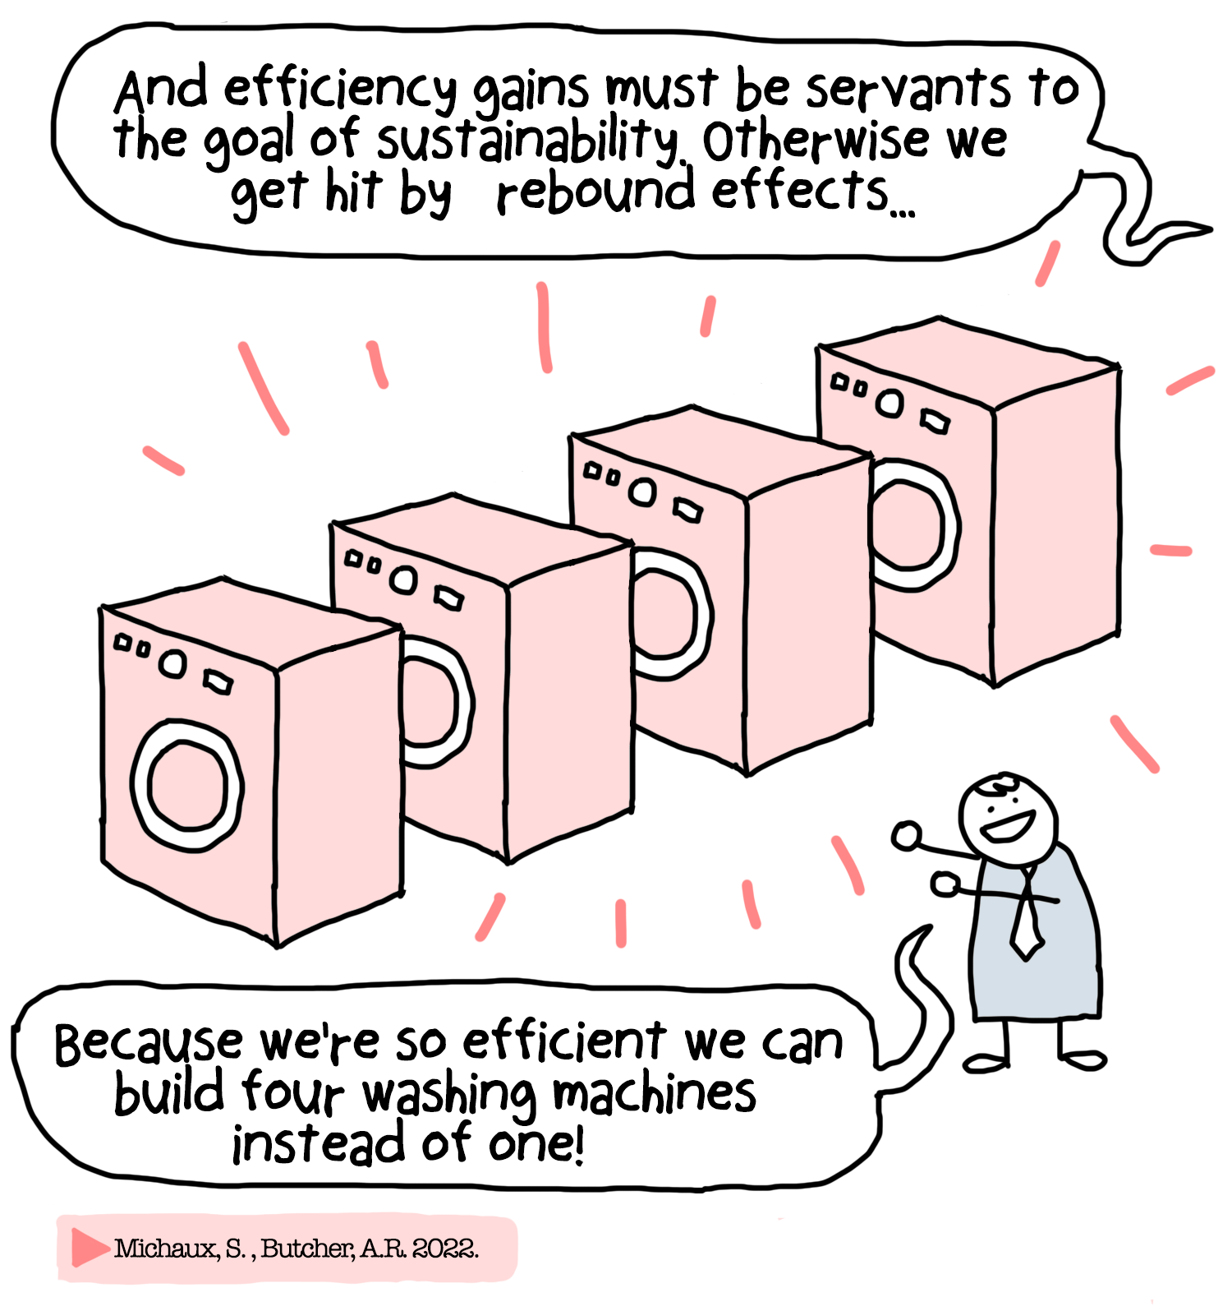

Slide 38
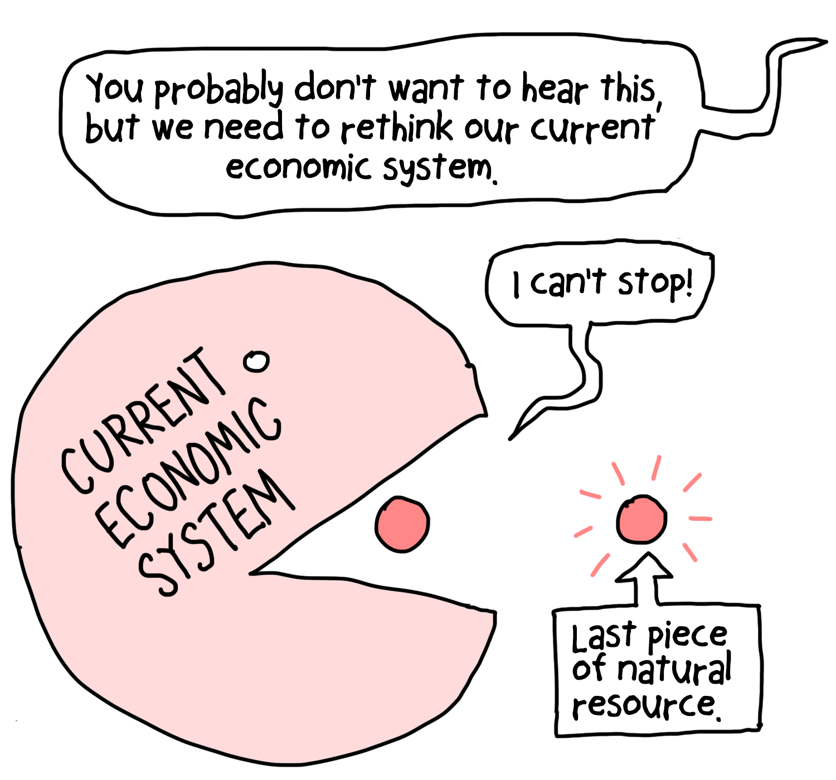

Slide 39
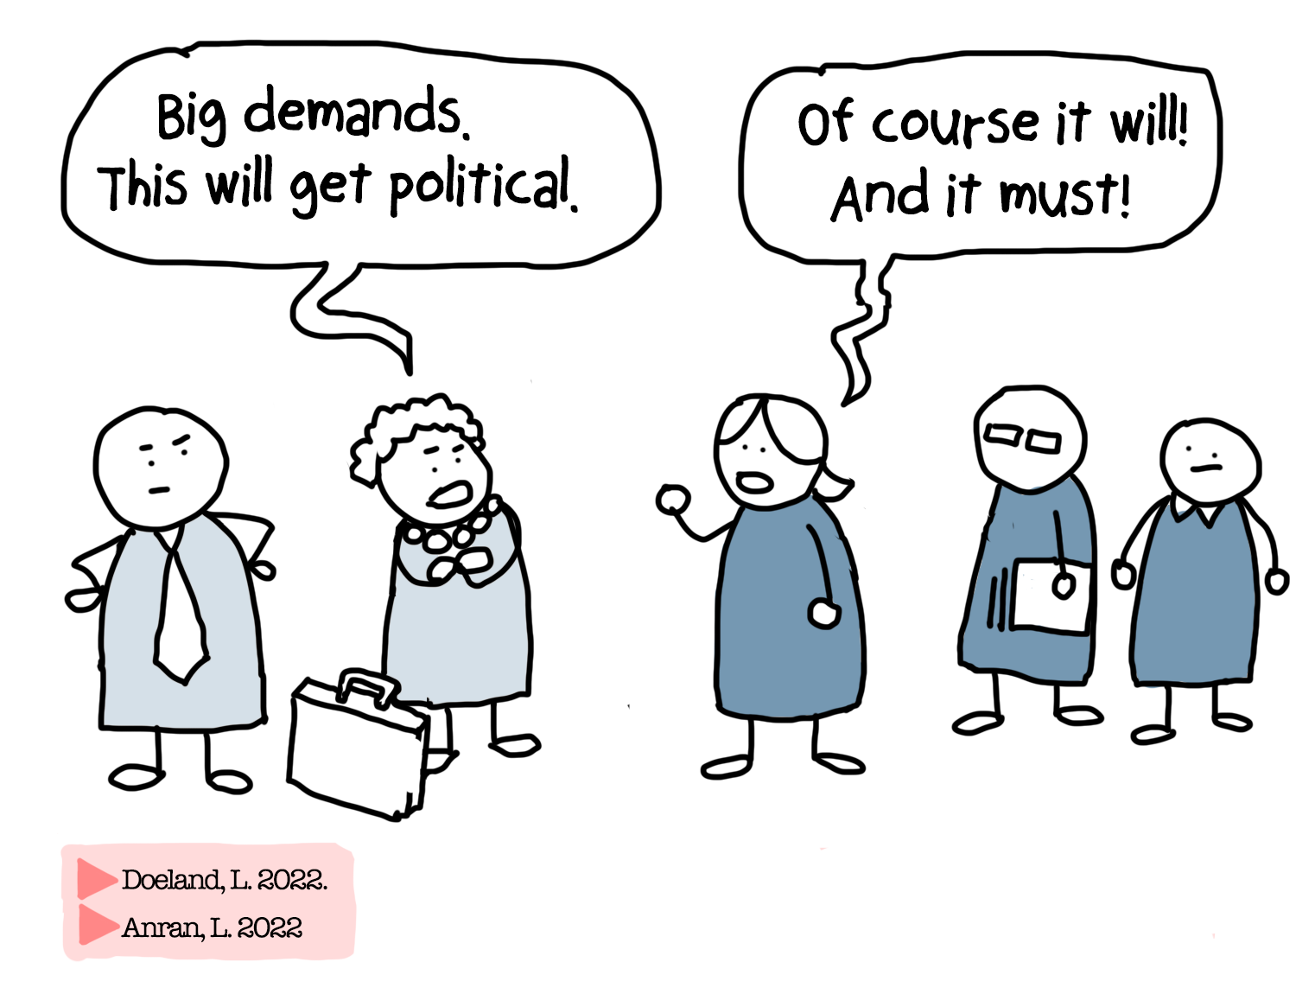

Slide 40
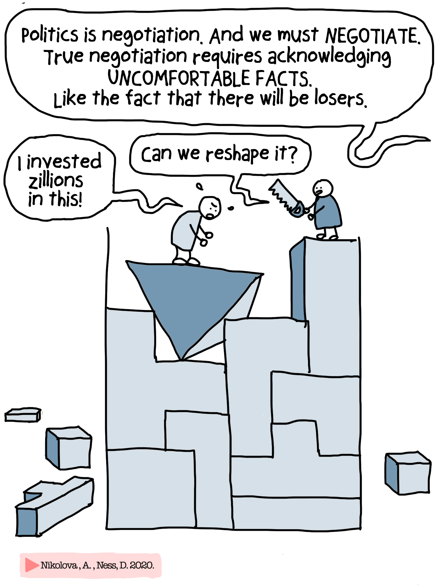

Slide 41
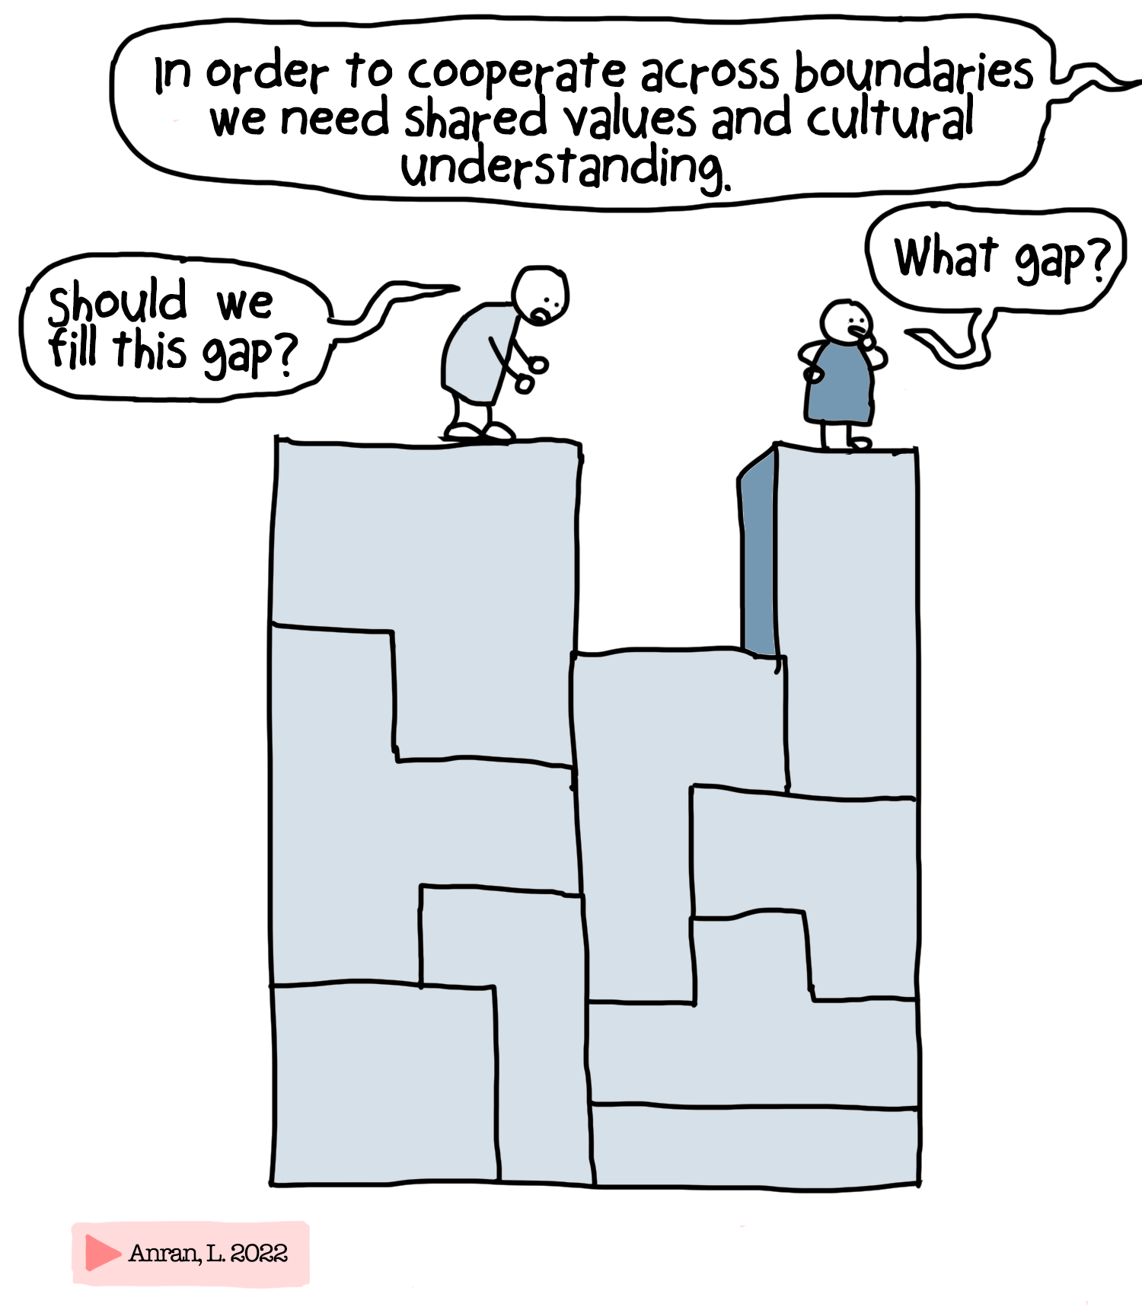

Slide 42
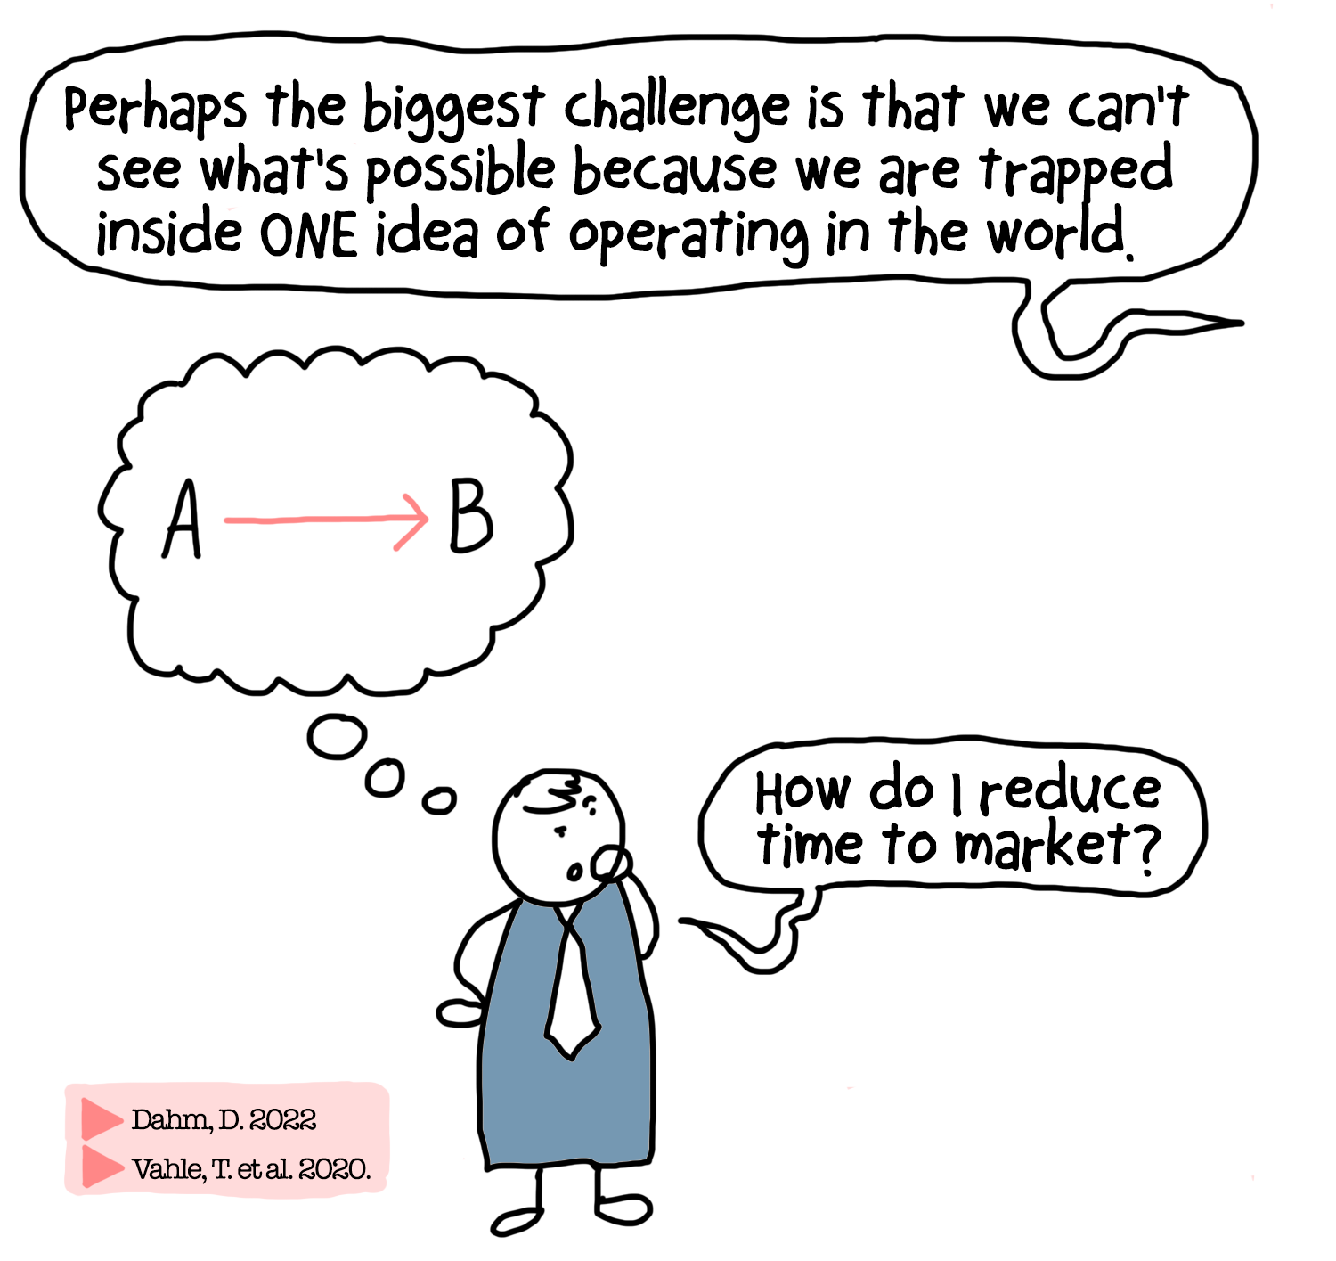

Slide 43
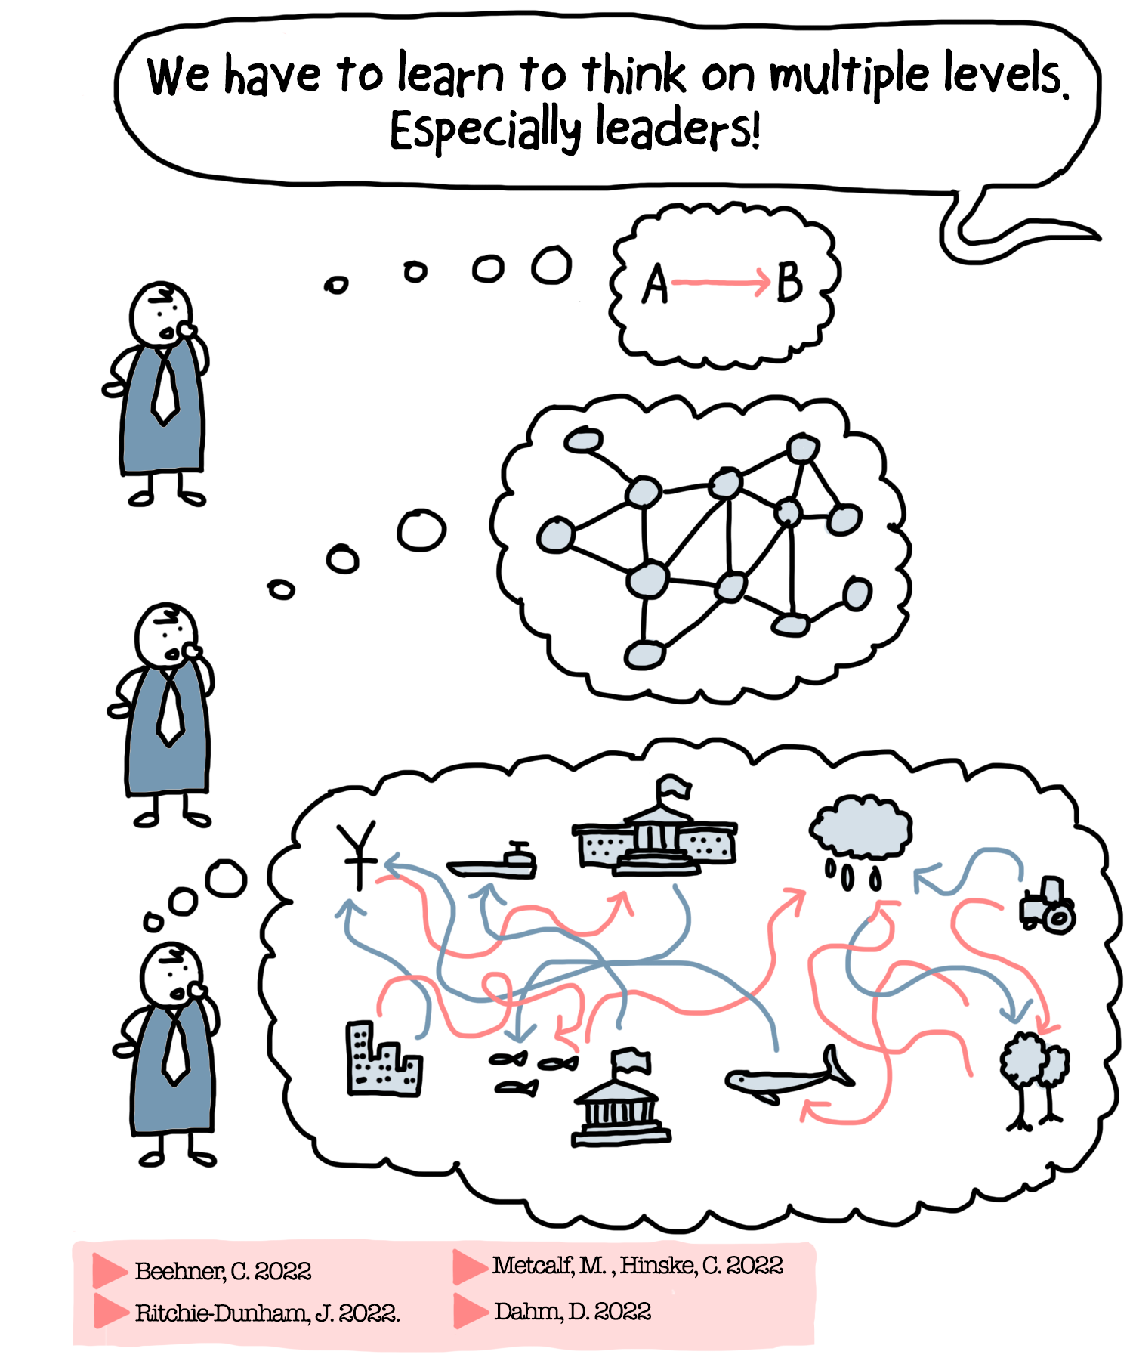

Slide 44
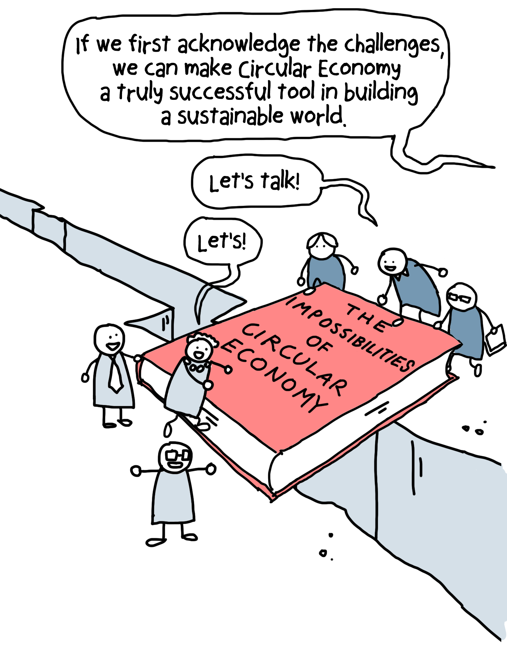

Slide 45
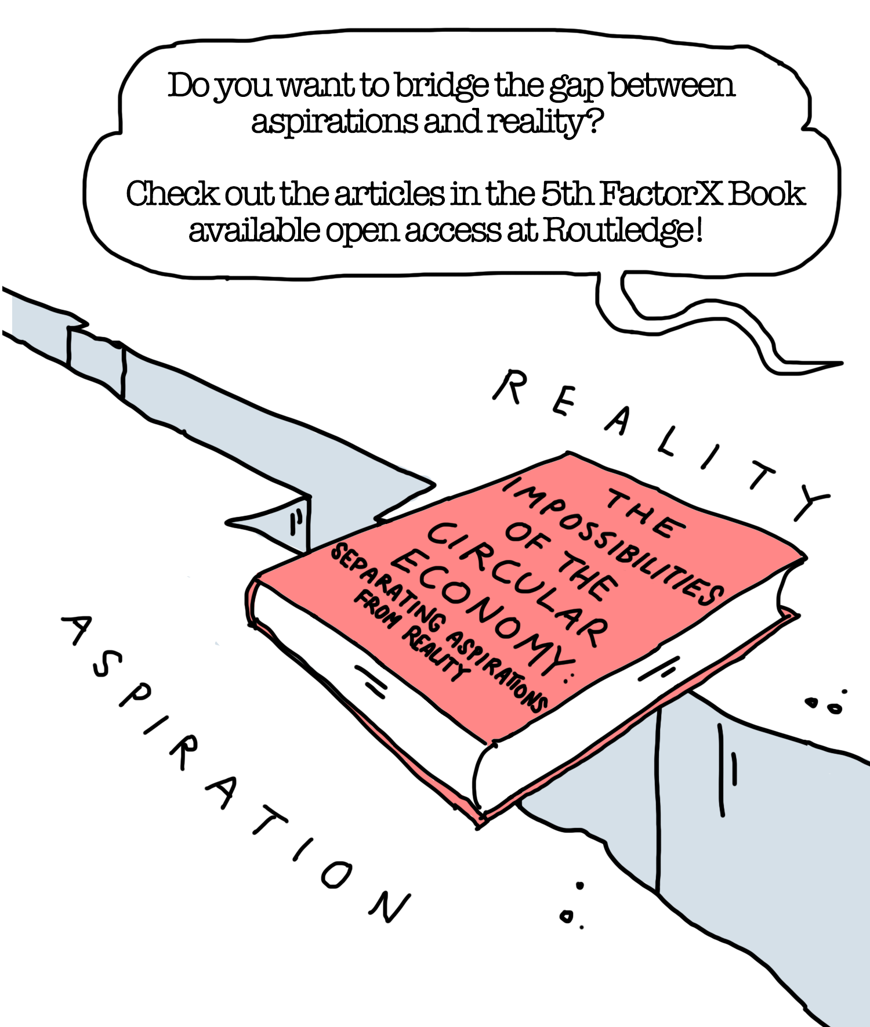
BOOK SERIES
Factor X: Studies in Sustainable Natural Resource Management

Slide 46
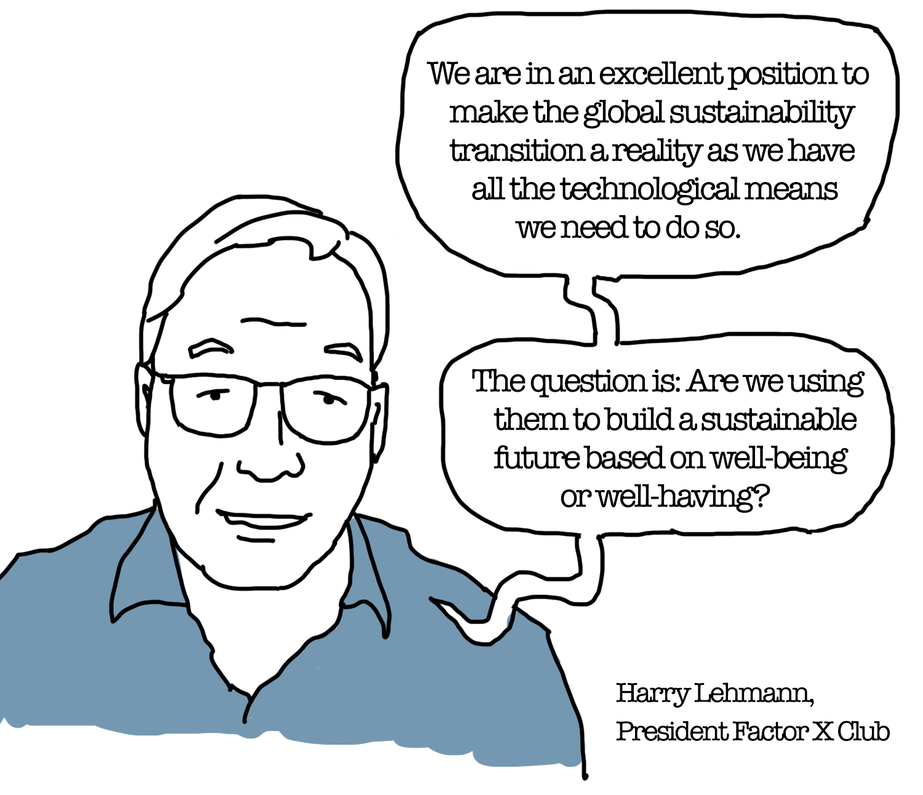

Slide 47
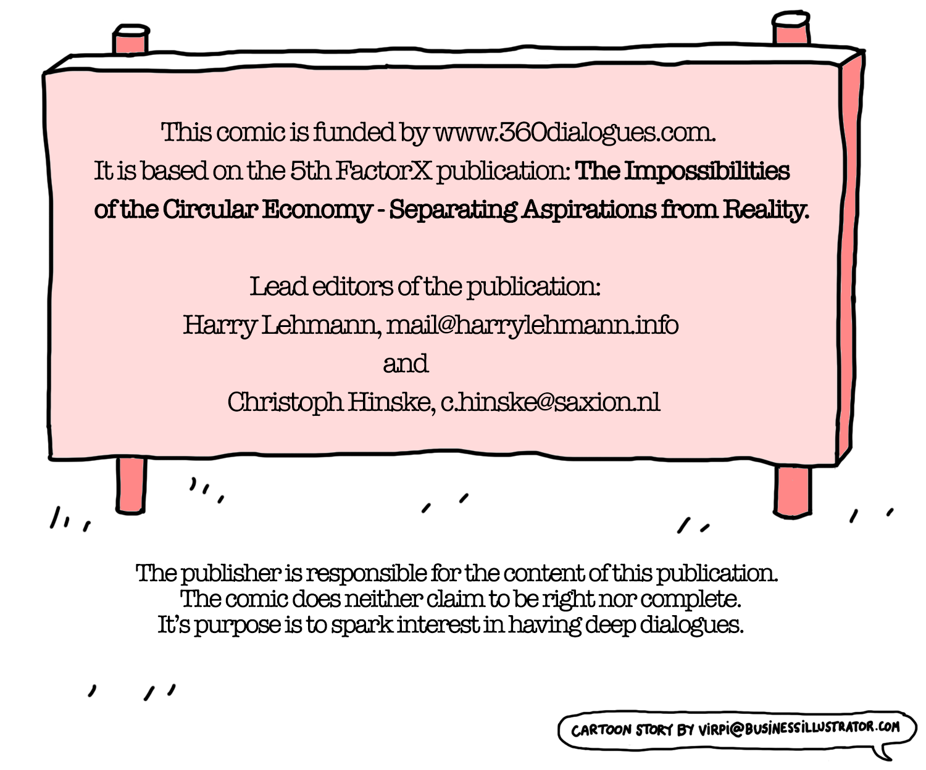

Slide 48
The Impossibilities of the Circular Economy
Separating Aspirations from Reality - THE COMIC
Daniel Dahm, United Sustainability Group, Germany
Lisa Doeland, Radboud University Nijmegen, Netherlands
Klaus Dosch, Factor X Agency, Indeland GmbH, Germany
Martin Faulstich, TU Dortmund University, Germany
Henning Friege, N³ Thinking Ahead, Germany
Mario Giampietro, Universitat Autònoma de Barcelona, Spain
Monika Gonser, Intersectoral School of Governance, Germany
Floris de Graad, Vegetarians Association, Netherlands
Willi Haas, University of Natural Resources and Life Sciences, Austria
Christoph Hinske, SAXION University of Applied Sciences, Netherlands
Sandra Hoomans, SAXION University of Applied Sciences, Netherlands
Jonas Huether, TU Dortmund University, Germany
Charlotte Joachimsthaler, TU Dortmund University, Germany
Helen Kopnina, Northumbria University, Newcastle Business School, U.K
Klaus Kuemmerer, Leuphana University Lüneburg, Germany
Anran Luo, University of Freiburg, Germany
Alexa Lutzenberger, ResScore GmbH, Germany
Reinier de Man, retired, Netherlands
Maureen Metcalf, Innovative Leadership Institute, U.S.A.
Simon P. Michaux, Geological Survey of Finland
David Ness, University of South Australia
Aneta Slaveikova Nikolova, UNESCAP, Thailand
Anna Hulda Olafsdottir, University of Iceland, Iceland
Nathalia Pimentel, GIZ GmbH, Brazil
Janez Potočnik, UN International Resource Panel, Belgium
James L. Ritchie-Dunham, Institute for Strategic Clarity, U.S.A.
Theodoros Semertzidis, University College London, U.K.
Roger Strand, University of Bergen, Norway
Martin Stuchtey, SYSTEMIQ, Germany
Harald Ulrik Sverdrup, Inland Norway University of Applied Sciences
Laís Thomaz, Universidade Federal de Goiás, Brazil
Tilmann Vahle, SYSTEMIQ, Germany
Corinna Vosse, Center for Cultural Research, Germany
Martin Welp, Eberswalde University for Sustainable Development, Germany
Comic based on the book of the same name, published in the FactorX series at Routledge in 2022.
The present comic is published and funded by www.360dialogues.com. It is based on the 5th Factor X publication from the Federal Environment Agency (UBA), The Impossibilities of the Circular Economy: Separating Aspirations from Reality.
The 5th Factor X book examines what the promise of an endless circle can and cannot deliver. Hence, it provides a solid starting point to advance circular approaches to our economies (including industrial and social processes) at a more fundamental level. Thus, it allows the reader to see through the marketing and policy charade that sells the circular economy as a silver bullet. The reader will recognise the insurmountability of specific barriers and thus be prepared not to invest their time and money in "investment dead ends”.
The comic is a condensation of key ideas present in the different articles. With engaging visuals, it shows the difference between possible and non-possible solutions for a more sustainable economy.
You are free to copy and redistribute the images in any medium or format as long as they follow the CC-BY-NC-ND 4.0 license agreements [Copy and distribute the material in any medium or format in unadapted form only, for noncommercial purposes only, and only so long as attribution is given to the creator. ]
We would like to thank the following actors for their support and many good ideas
The 5th Factor X book was funded by the Federal Environment Agency and the Federal Ministry for the Environment, Nature Conservation, Nuclear Safety and Consumer Protection. The funds are made available by resolution of the German Bundestag. Apart from this funding we, the lead editors, offer this comic illustrating the main topics of the book.
SAXION University of Applied Sciences | School of Finance and International Business for providing valuable expert contributions to the lead editors in the field of Systemic Value Creation and Innovation.
The authors of the 5th FactorX book: They solved the impossible riddle of providing us with a sentence expressing the essence of their scientific article. Without their dedication to engaged scholarship, this comic would've not been possible:
Safiqul Alam, GEOMARK LIMITED, Bangladesh
Ole van Allen, University of Applied Sciences, Hamar, Norway
Mariusz Baranowski, Adam Mickiewicz University, Poland
Christopher Beehner, Seminole State College of Florida, U.S.A.
Francesco Boatta, Vrije Universiteit Amsterdam, Netherlands
Suzana Borschiver, Universidade Federal do Rio de Janeiro, Brazil
Tom Bosschaert, Except Integrated Sustainability, Netherlands
Mariana Bozesan, AQAL Foundation & AQAL Capital, Germany
Alan R. Butcher, Geological Survey of Finland
About the Comic
The comic is optimised for desktop, laptop, mobile phone or tablet. The references in the comic refer to articles in the book: The impossibilities of the Circular Economy - Separating Aspirations from Reality, published in 2022 by Routledge | Taylor&Francis
Comic Editors: Christoph Hinske, Harry Lehmann
Editorial: Christoph Hinske, Martina Eick Contact: christoph.hinske@theengagementcompany.co Comic story and art: Virpi Oinonen Contact: virpi@businessillustrator.com
The publisher is responsible for the content of this publication.

